Slide 1
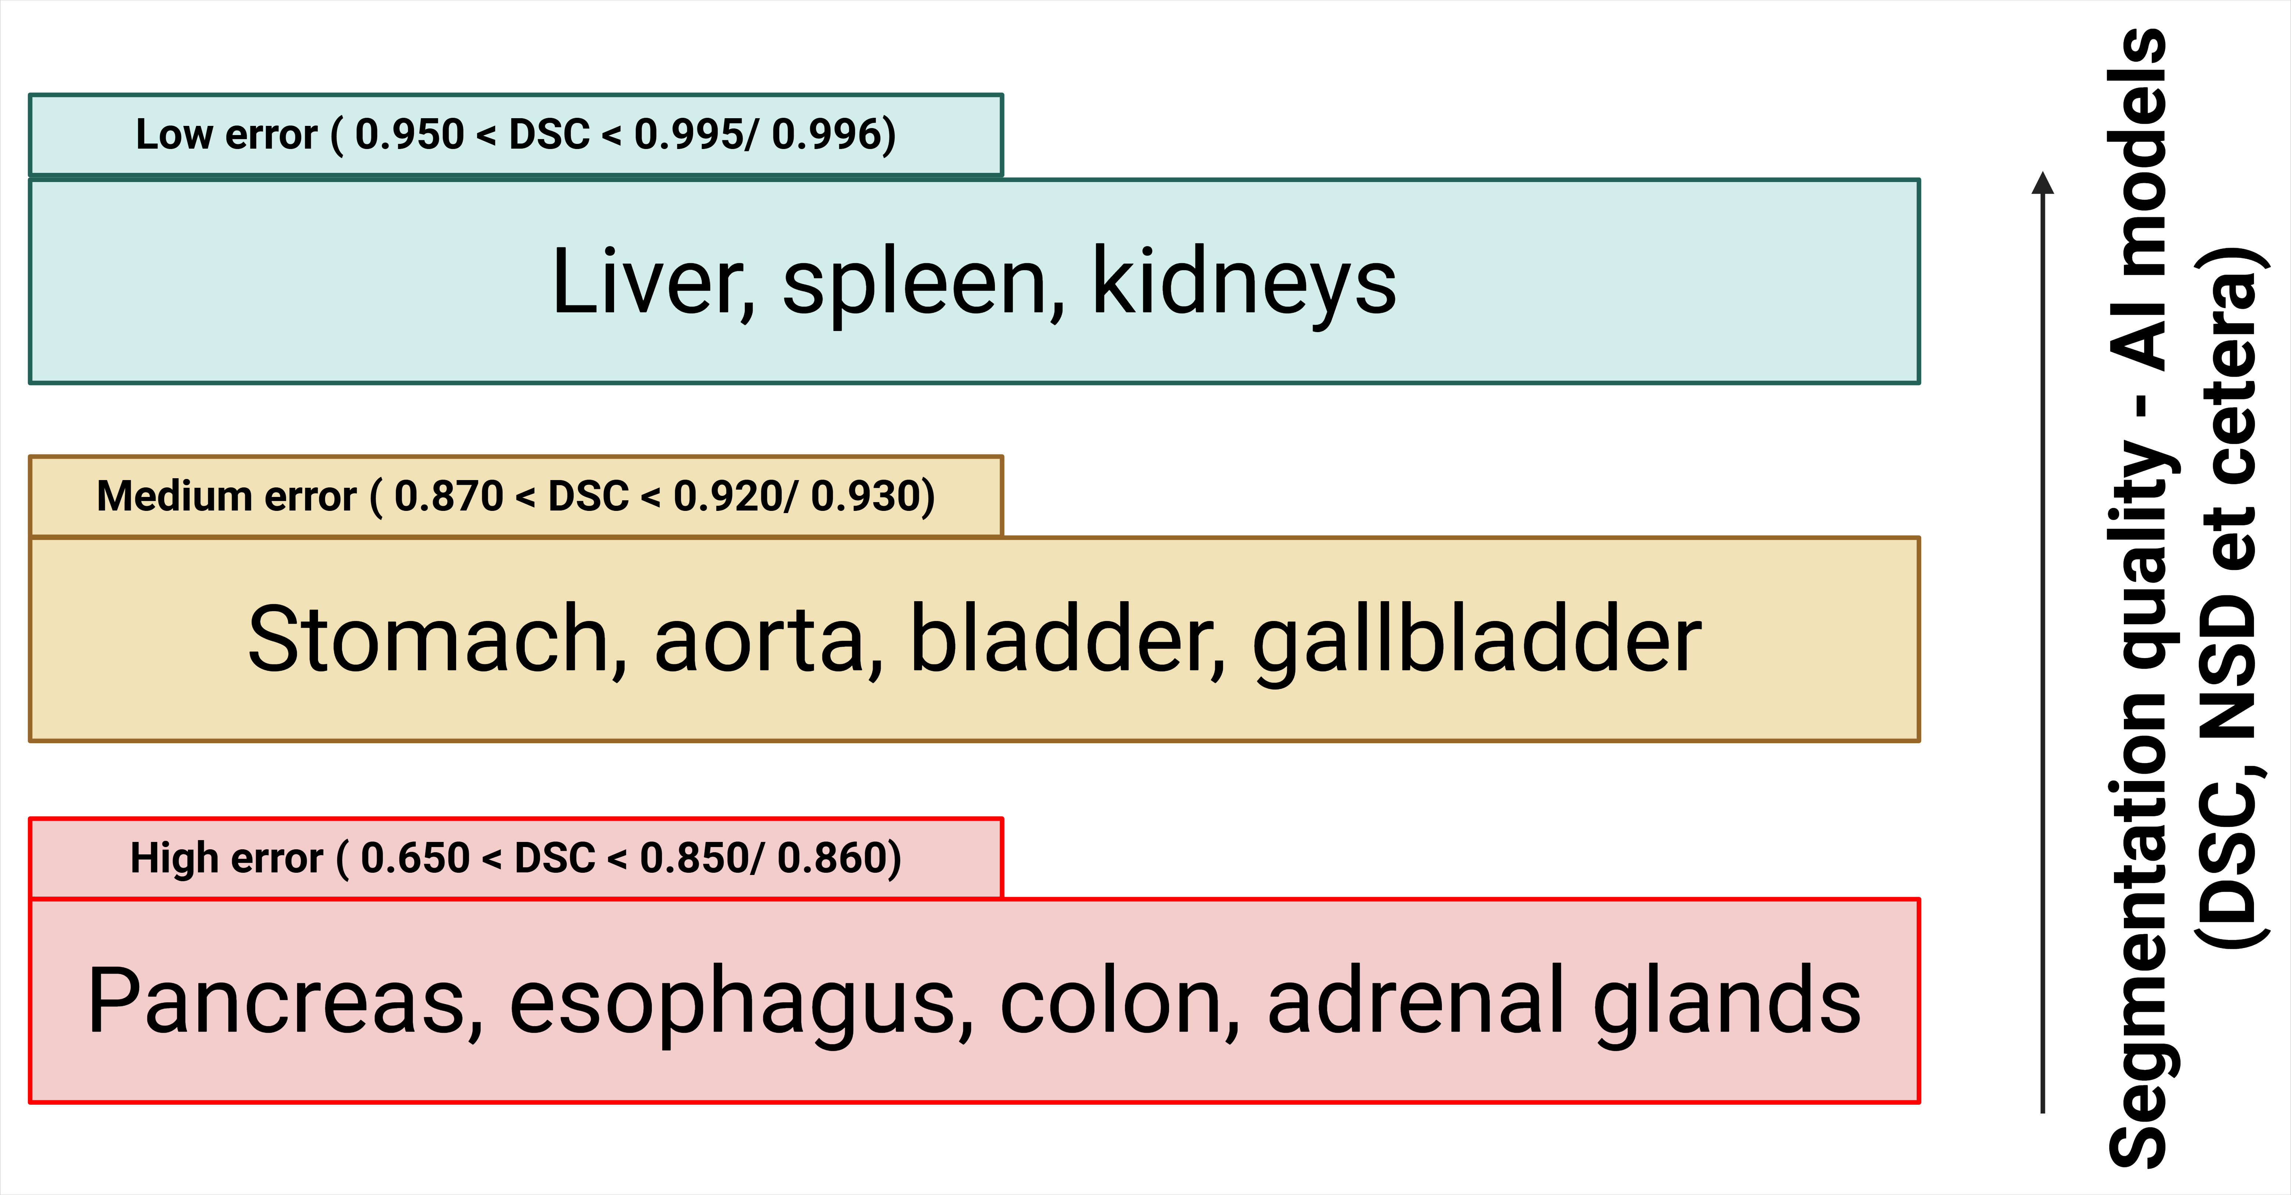
Error characterization protocol
Why error characterization?
Several benchmarking studies exist, which categorize organs based on difficulty of segmentation by AI-based models [1—4]:
Score | Explanation
Dice Similarity Coefficient (DSC) | Volume (V) overlap
Intersection over Union (IoU) | Surface area (SA) overlap
Normalized Surface Dice (NSD) | Boundary overlap within tolerance distance $t$.
[1] Jeon et al, 2024, Scientific Reports.
[3] Ji et al, 2022, “AMOS,” arXiv, PDF.
[2] Luo et al, 2022, Medical Image Analysis.
[4] Wasserthal et al, 2023, “TotalSegmentator,” Radiology. Artificial Intelligence.

Slide 2
Error characterization protocol
Why error characterization? (2)
We are not just interested in quality of segmentation (good, moderate, bad) — we are more interested in the type of segmentation errors.

Slide 3
Error characterization protocol
Aims
Q1: Can we rank organs as per susceptibility to being under- or over-segmented?
Q2: Organ-wise characterization of more nuanced errors
Comparative analyses: How does the segmentation model erroneously alter the segmentation characteristics of the organ?
Causal analyses: What features lead to what kinds of errors?

Slide 4
Error characterization protocol
Aims (2)
Q3: Magnitude and direction of error relative to the organ
Q4: Which organ-specific features are scalable, and by how much?
Comparative analyses: What are the exceptions?
Causal analyses: Why the exceptions?

Slide 5
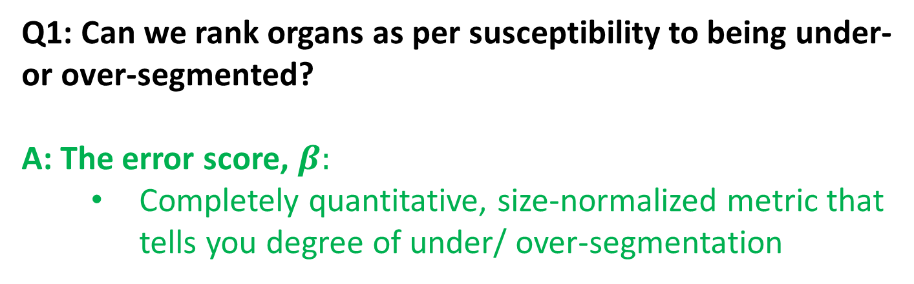
Error characterization protocol
Overview of analysis framework
Q1: Can we rank organs as per susceptibility to being under- or over-segmented?
A: The error score, $β:$
Completely quantitative, size-normalized metric that tells you degree of under/ over-segmentation

Slide 6
Error characterization protocol
Overview of analysis framework (2)
Q2: Organ-wise characterization of more nuanced errors
Comparative analyses:
Same feature b/w ground truth (GT) & predicted (Pd)
Correlation
Simple linear regression
Explanatory (causal) analyses:
Different feature between GT and Pd
Regression
Correlation

Slide 7
Error characterization protocol
Overview of analysis framework (3)
Q3: Magnitude and direction of error relative to the organ
Magnitude and direction of anisotropy + DSC:
DSC + Magnitude of anisotropy + Direction
Combines magnitude, direction, normalization by size, ignores local statistics:
Shape preservation metric, M1

Slide 8
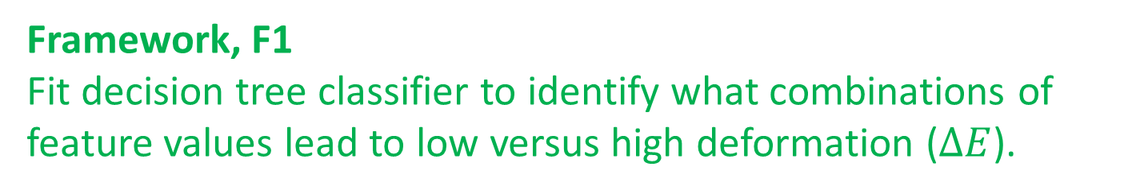
Error characterization protocol
Overview of analysis framework (4)
Q4: Which organ-specific features are scalable, and by how much?
Comparative analysis:
What are the exceptions?
Explanatory (causal analyses):
Why the exceptions?
Framework, F1
Fit decision tree classifier to identify what combinations of feature values lead to low versus high deformation ($ΔE$).

Slide 9
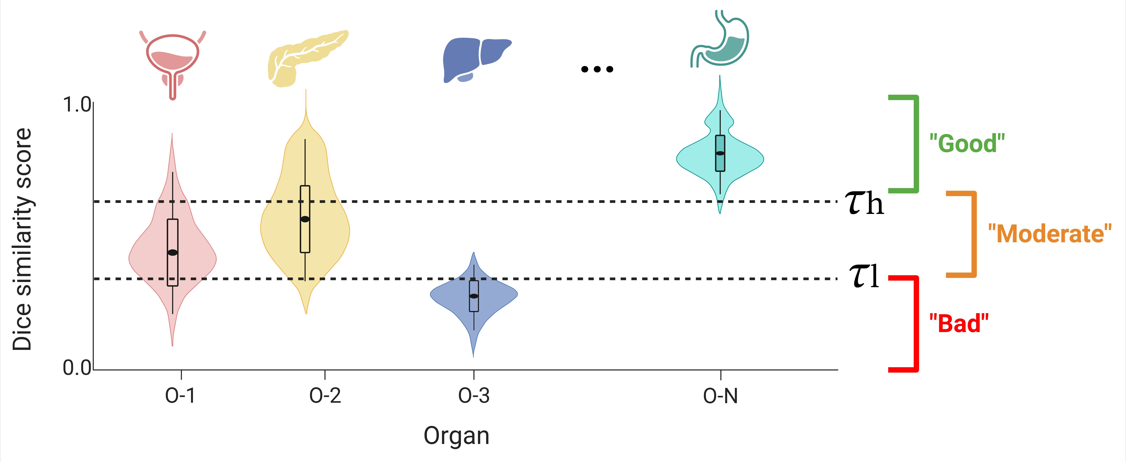
Error characterization protocol
The analysis framework – Q1
Q1: Ranking organs as per susceptibility to being under- or over-segmented
State-of-the-art (segmentation QA)
Our Phase 1 (extent of under-/ over-segmentation)

Slide 10
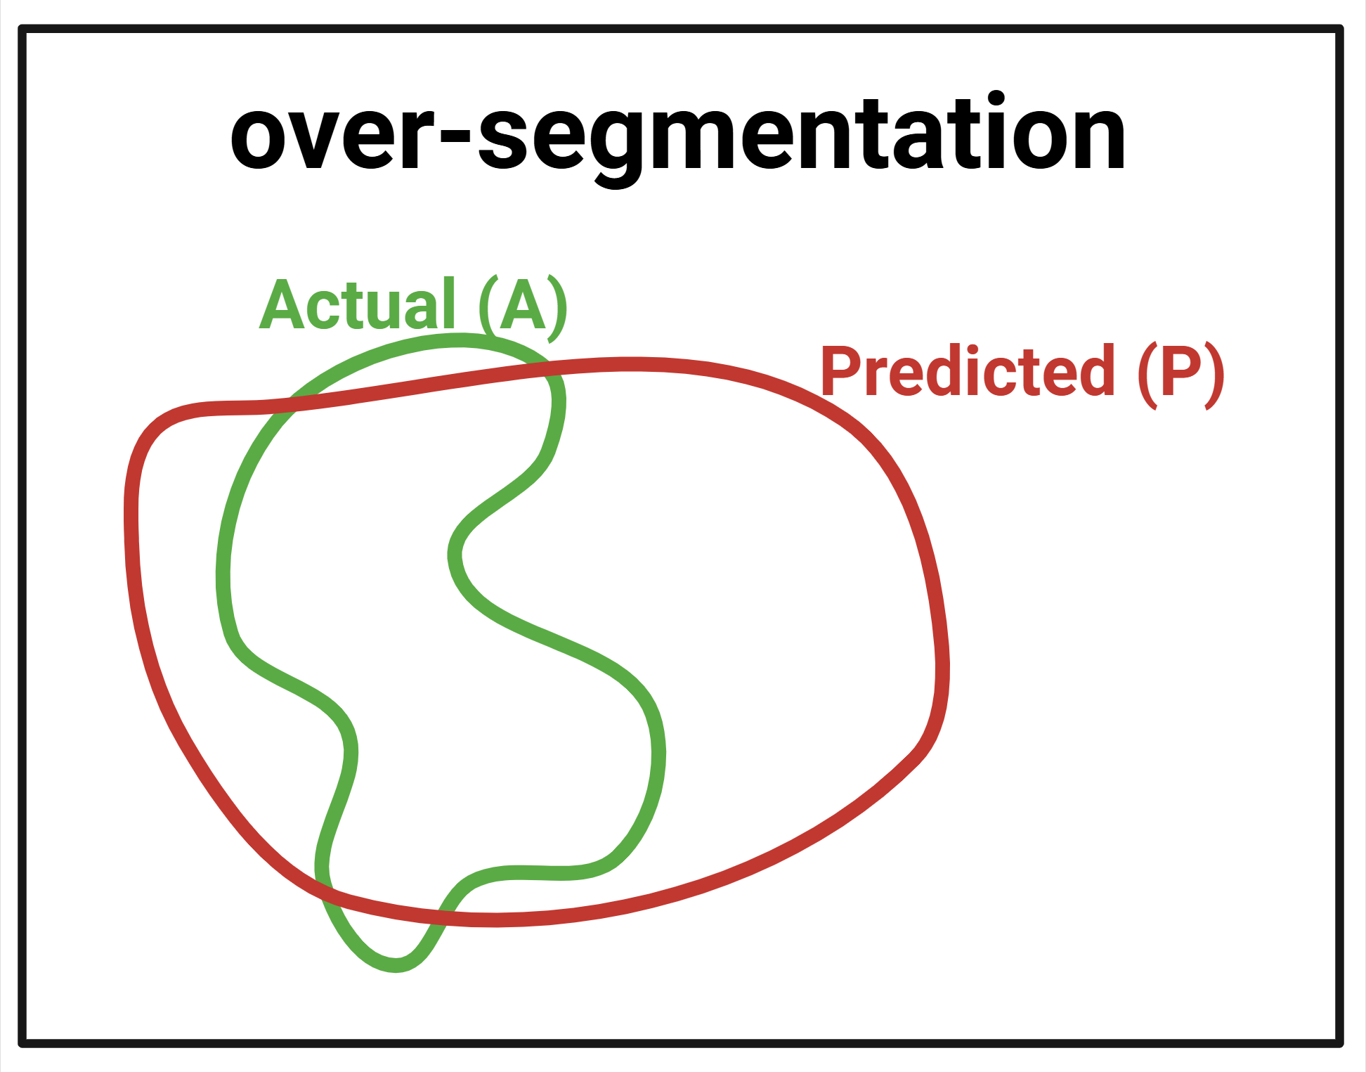
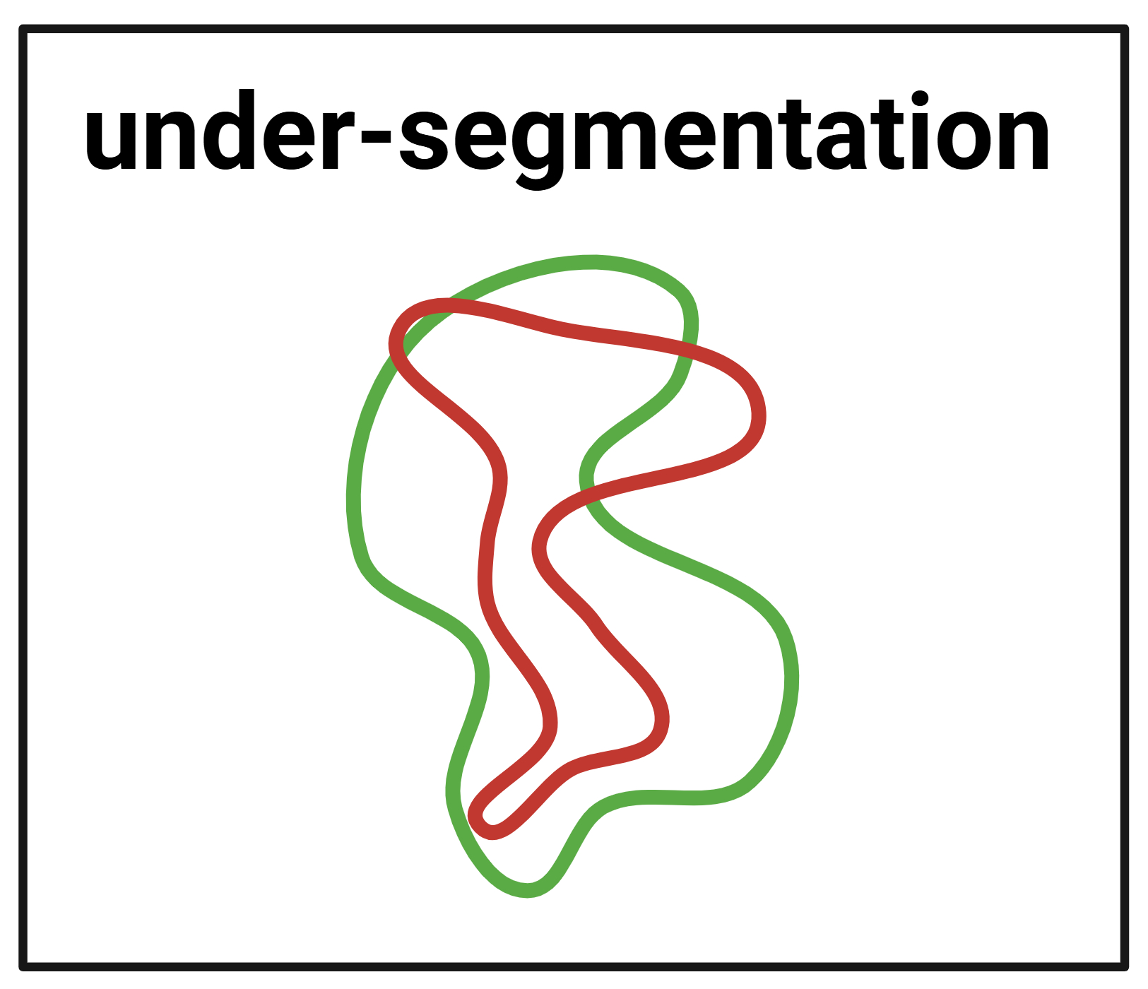
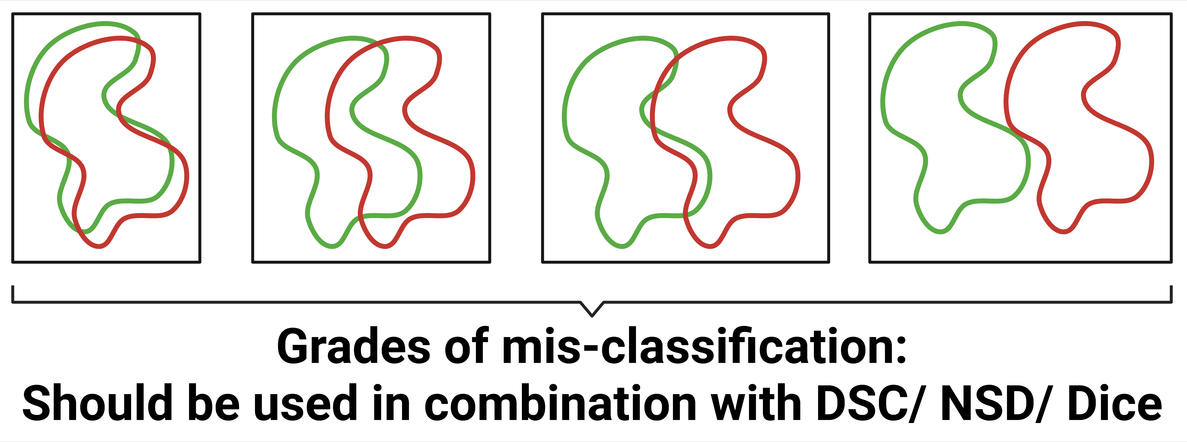
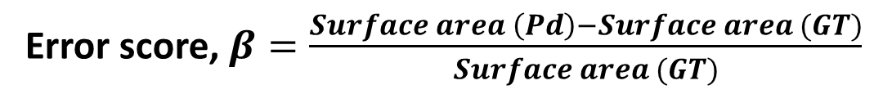
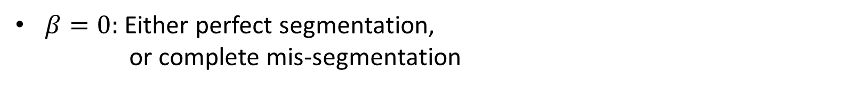
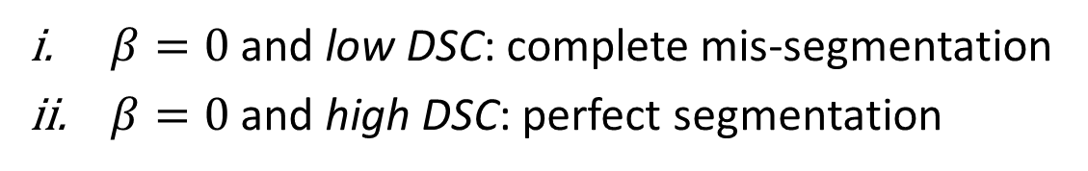
Error characterization protocol
The analysis framework – Q1
Q1: Ranking organs as per susceptibility to being under- or over-segmented (2)
Error score, $β=\frac{Surface area \left(Pd\right)−Surface area (GT)}{Surface area (GT)}$
$β>0:$ over-segmentation
$β<0:$ under-segmentation
$β=0:$ Either perfect segmentation,
or complete mis-segmentation
$β=0$ and low DSC: complete mis-segmentation
$β=0$ and high DSC: perfect segmentation
Therefore, setting an upper and lower bound (thresholds) on $β$ and DSC solve the problem.

Slide 11
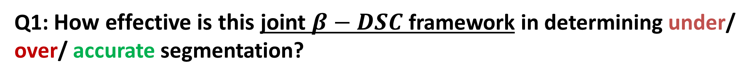
Error characterization protocol
The analysis framework – Q1
Q1: How effective is this joint $β−DSC$ framework in determining under/ over/ accurate segmentation?
Examples shown on 6 samples per organ. (Note: only 3D rendering, not 2D.)
But first, let us recap the organs of interest:

Slide 12
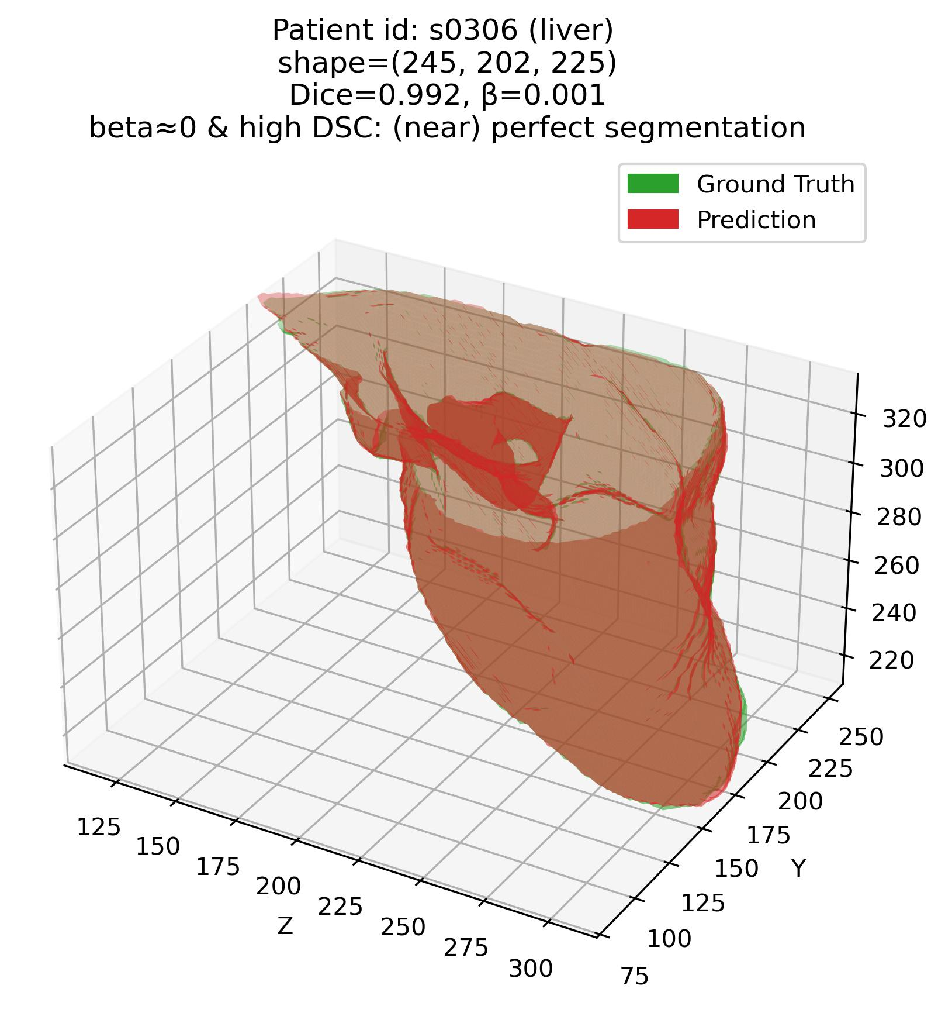
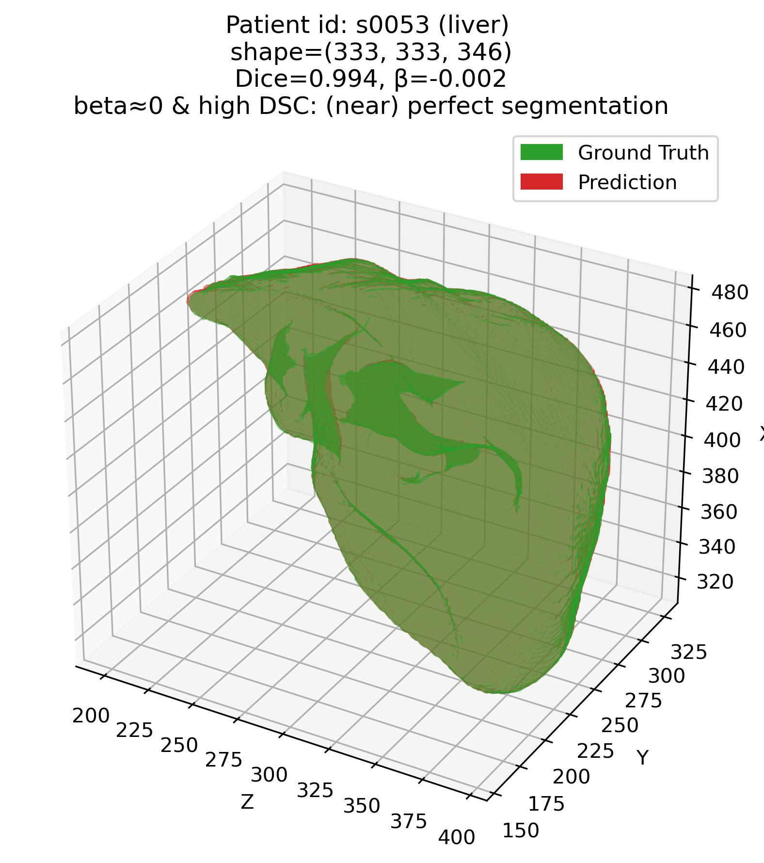
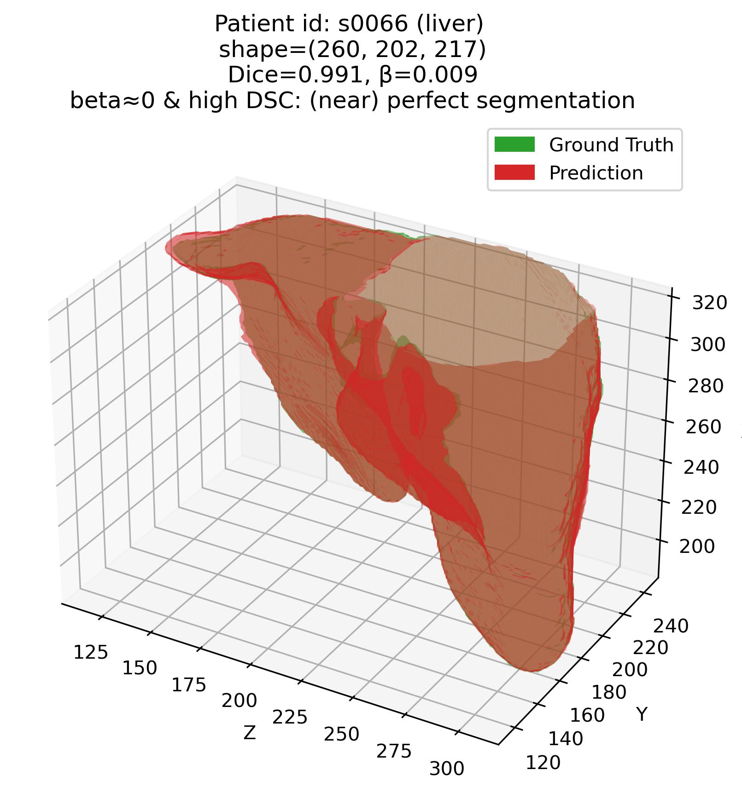
Error characterization protocol
The analysis framework – Q1
Q1: Some examples – 1. Liver (Easy – high DSC organ)

Slide 13
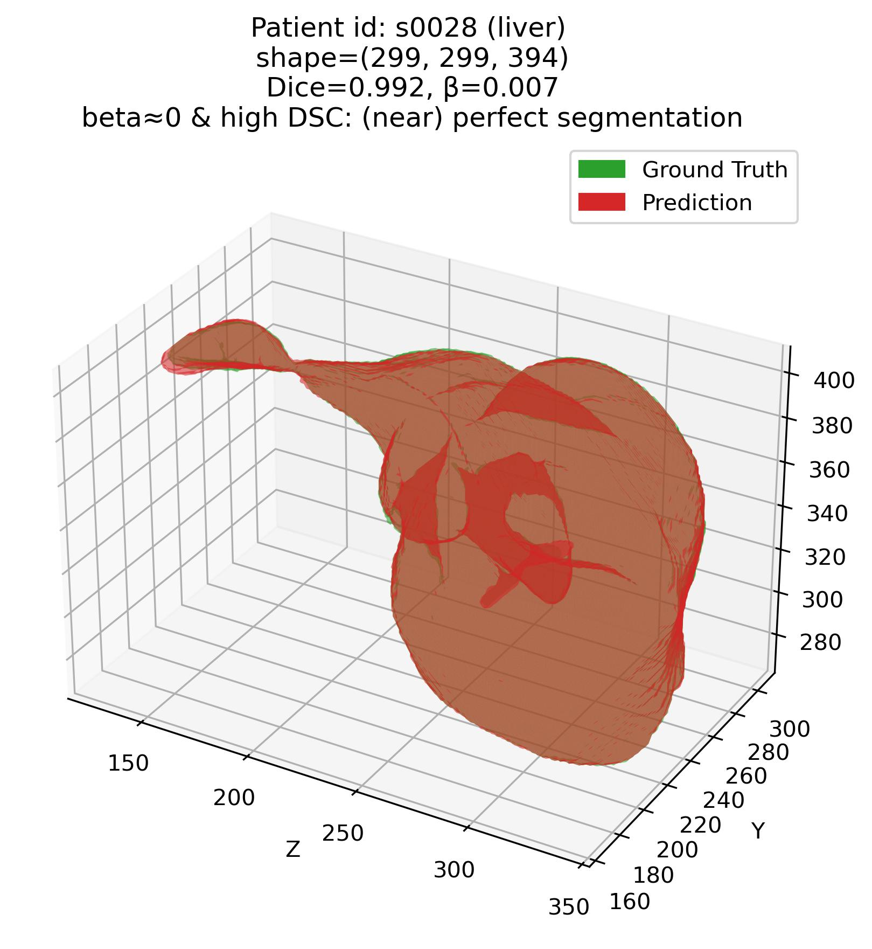
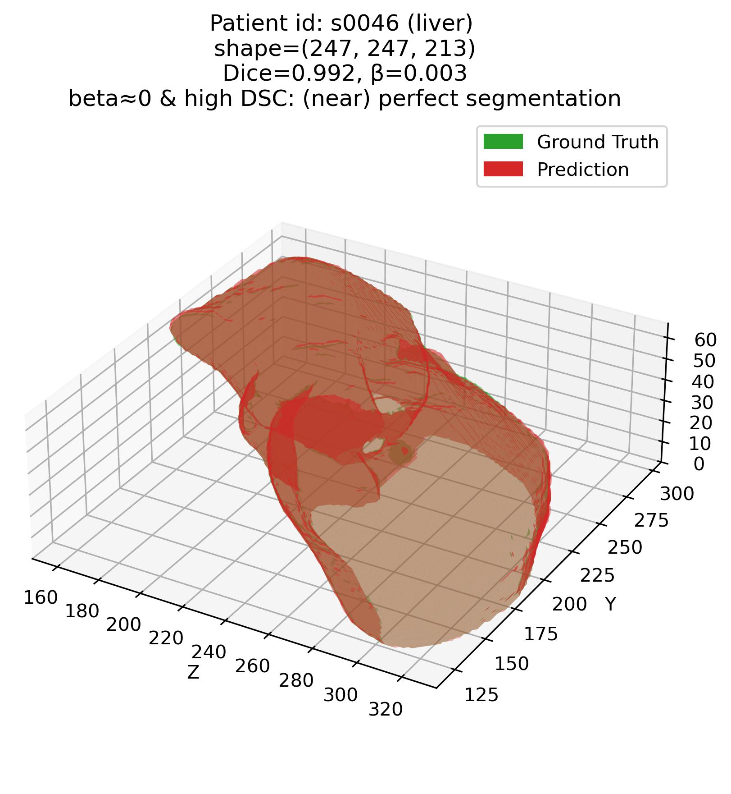
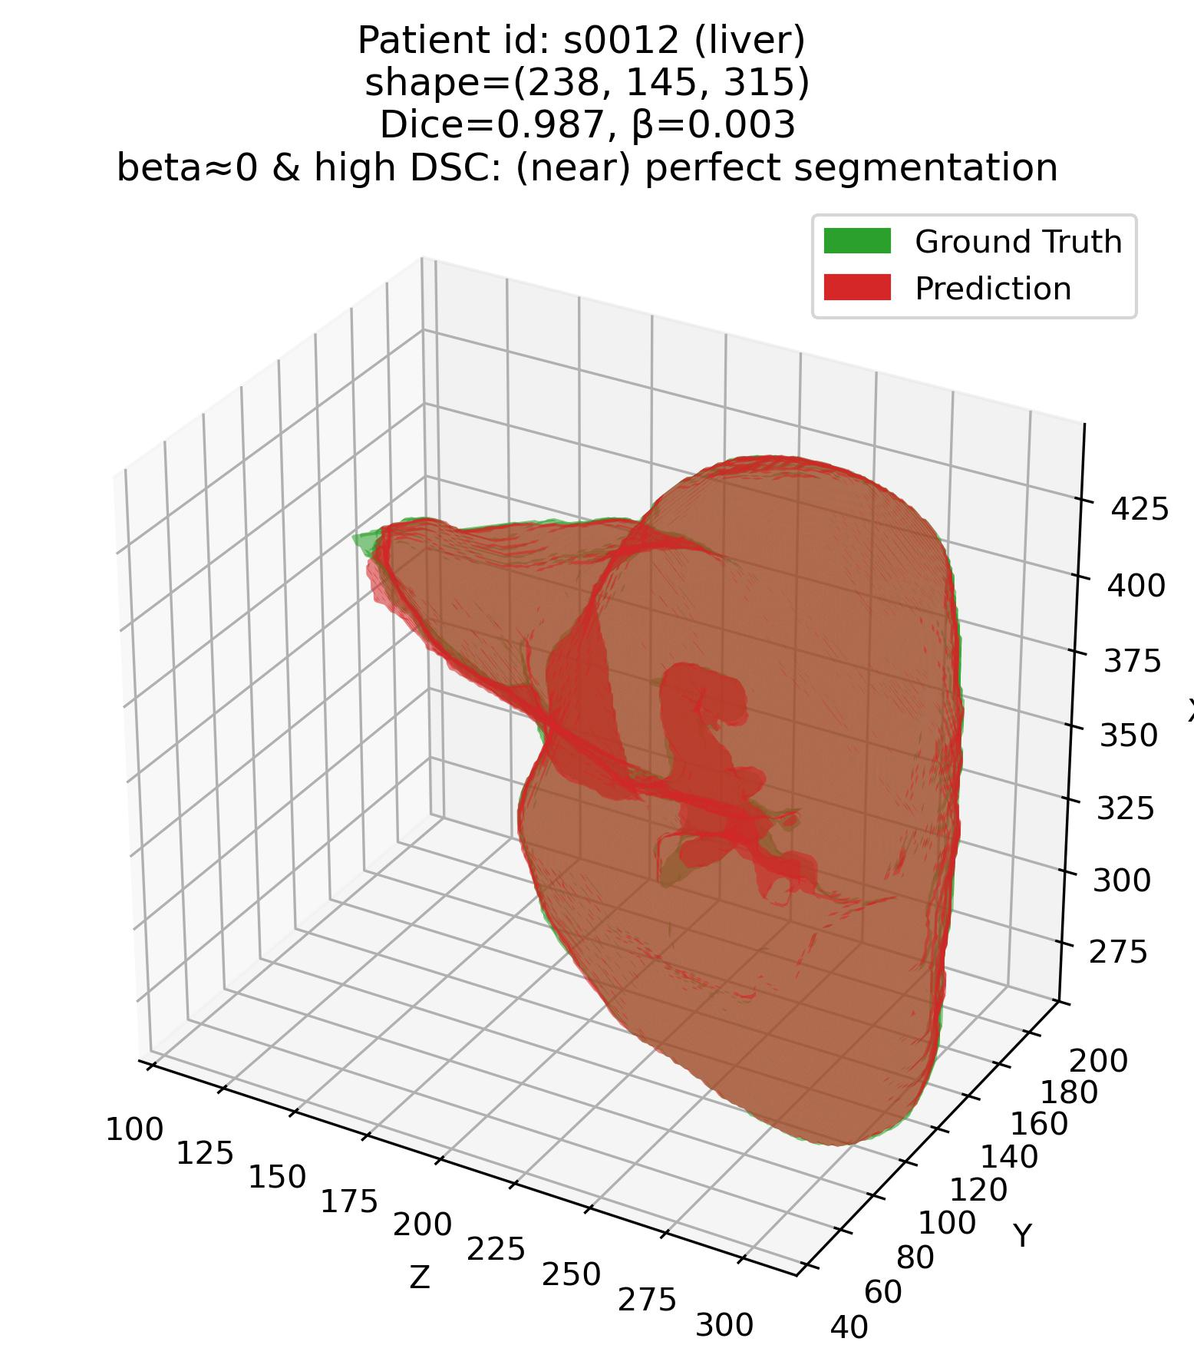
Error characterization protocol
The analysis framework – Q1
Q1: Some examples – 1. Liver (Easy – high DSC organ)

Slide 14
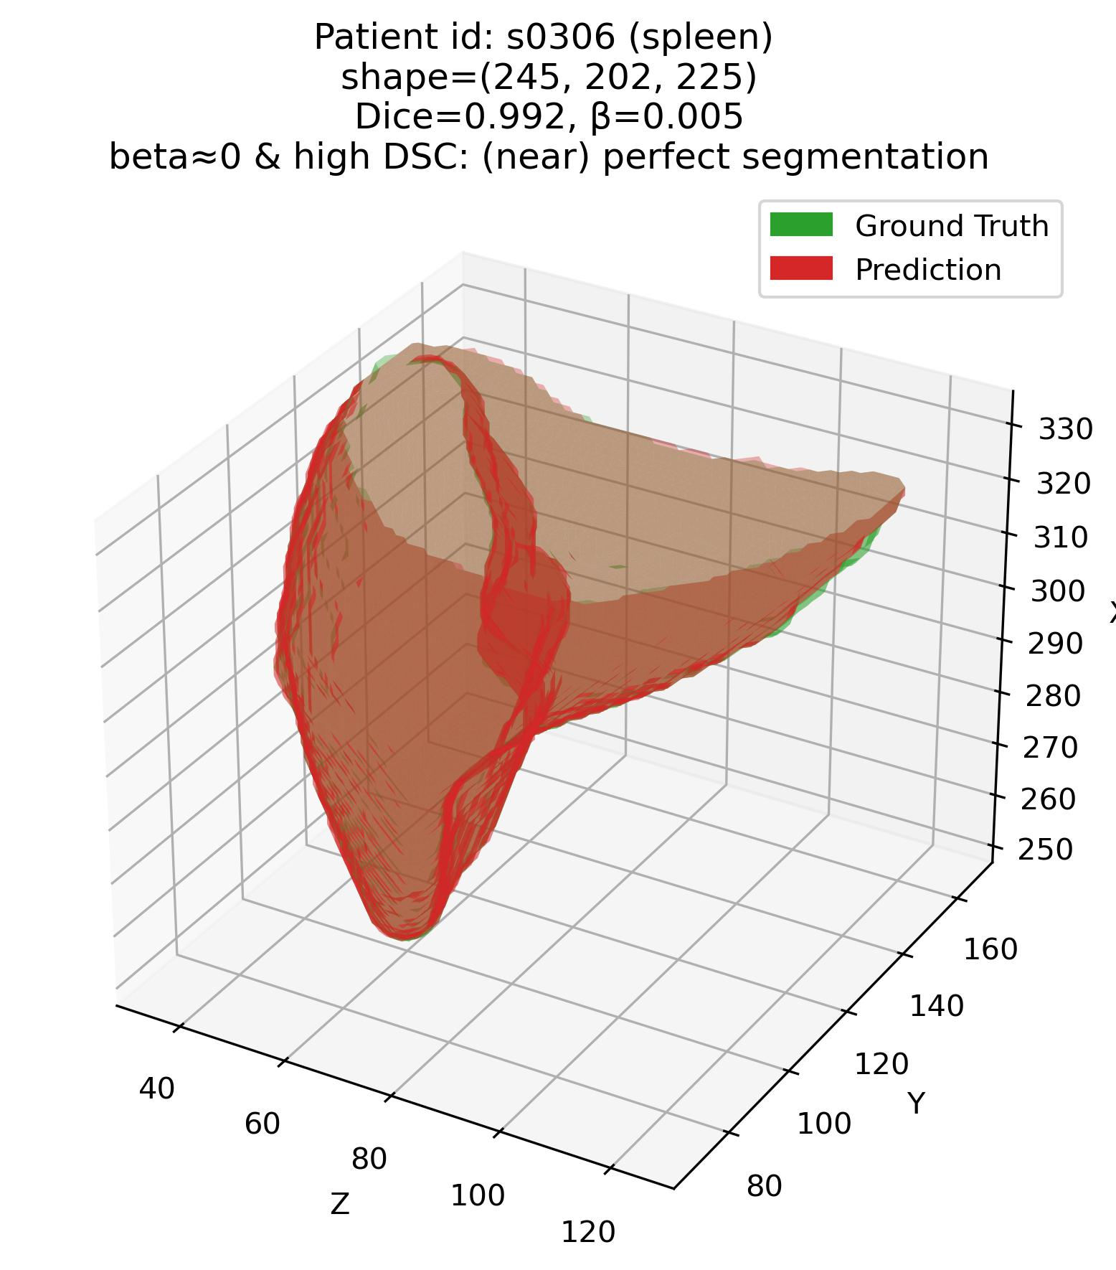
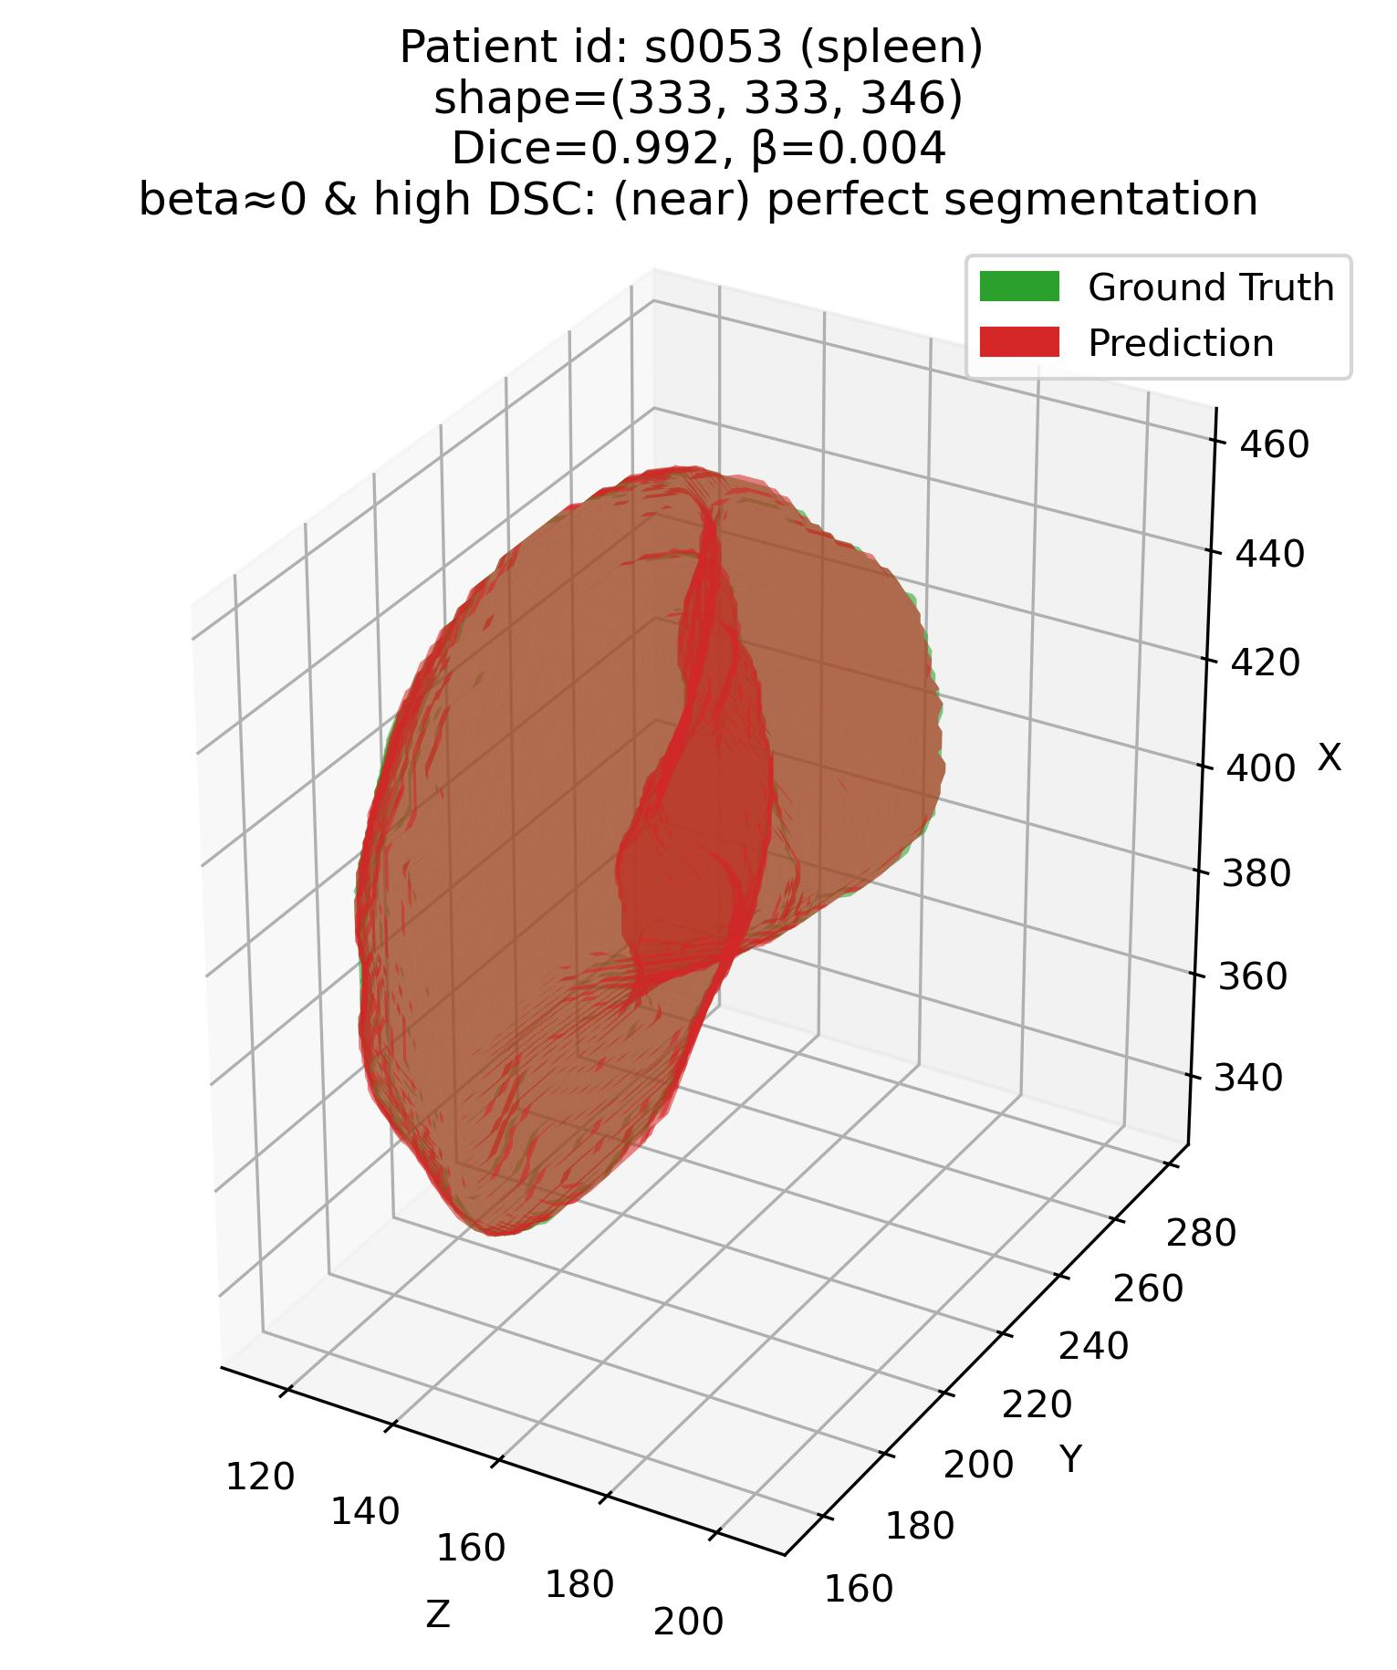
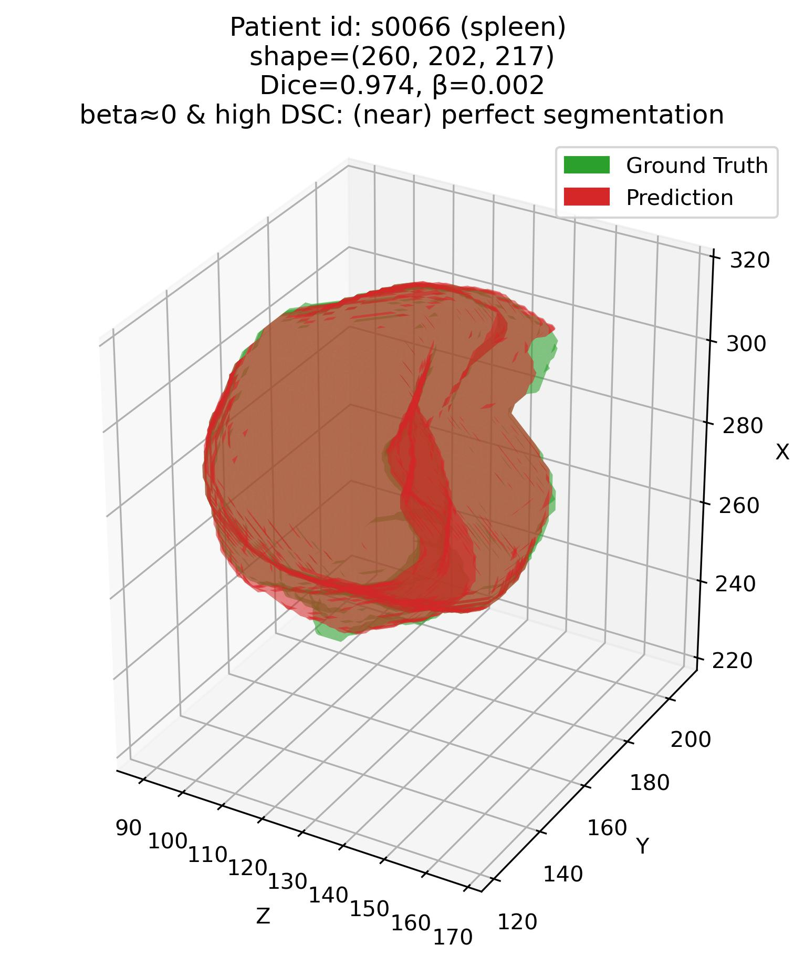
Error characterization protocol
The analysis framework – Q1
Q1: Some examples – 2. Spleen (Easy – high DSC organ)

Slide 15
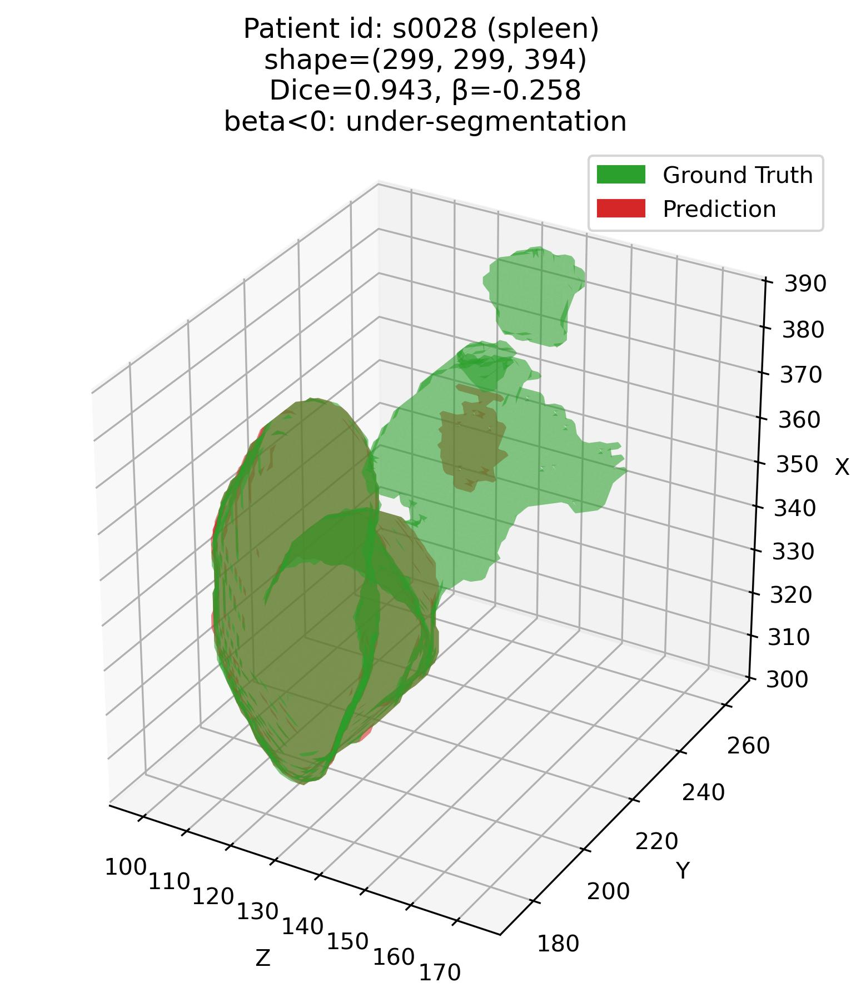
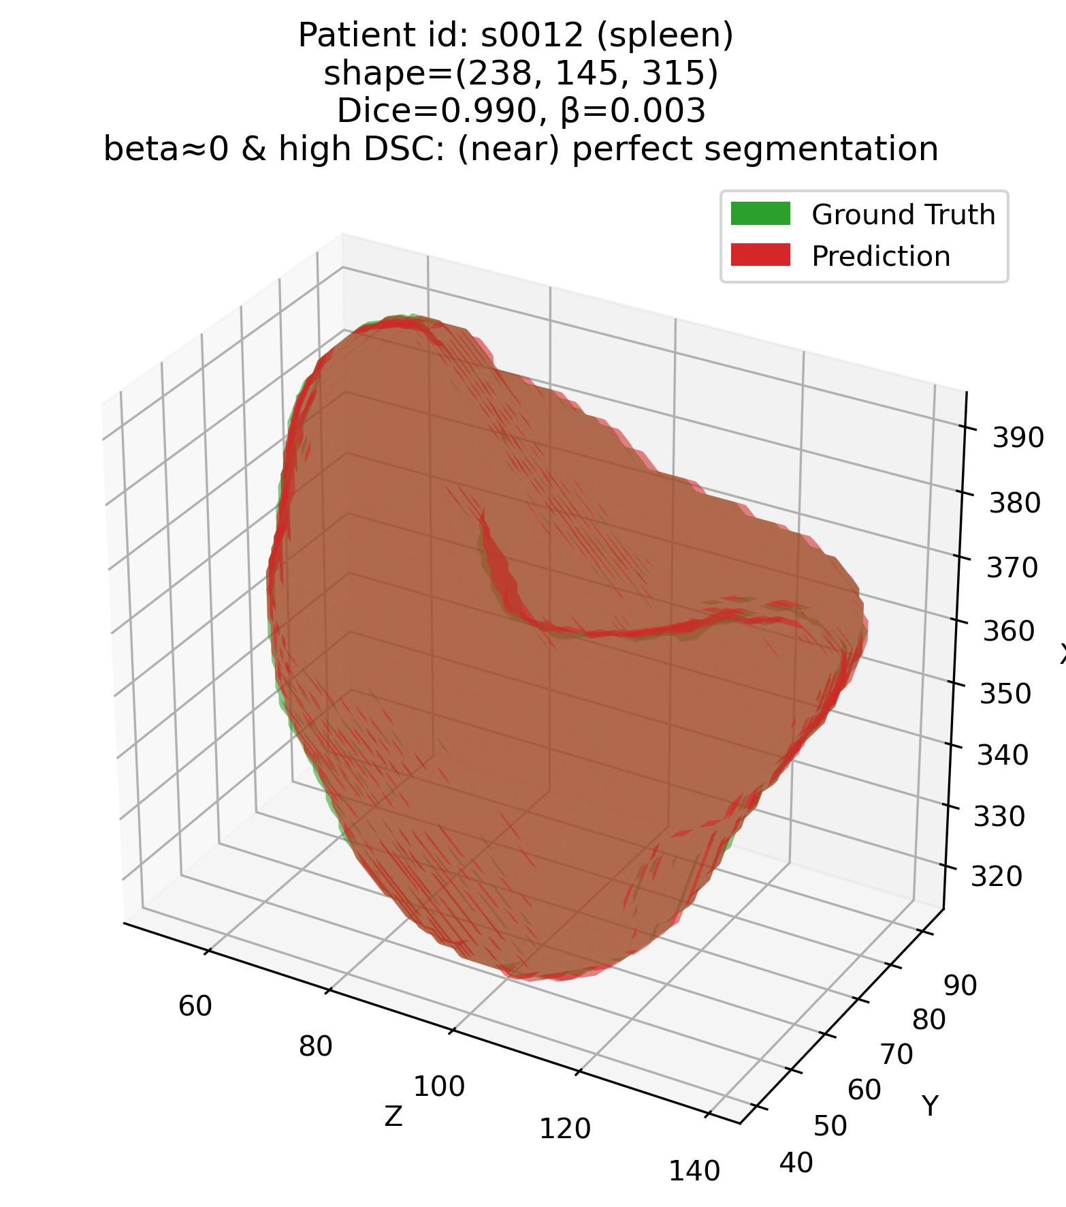
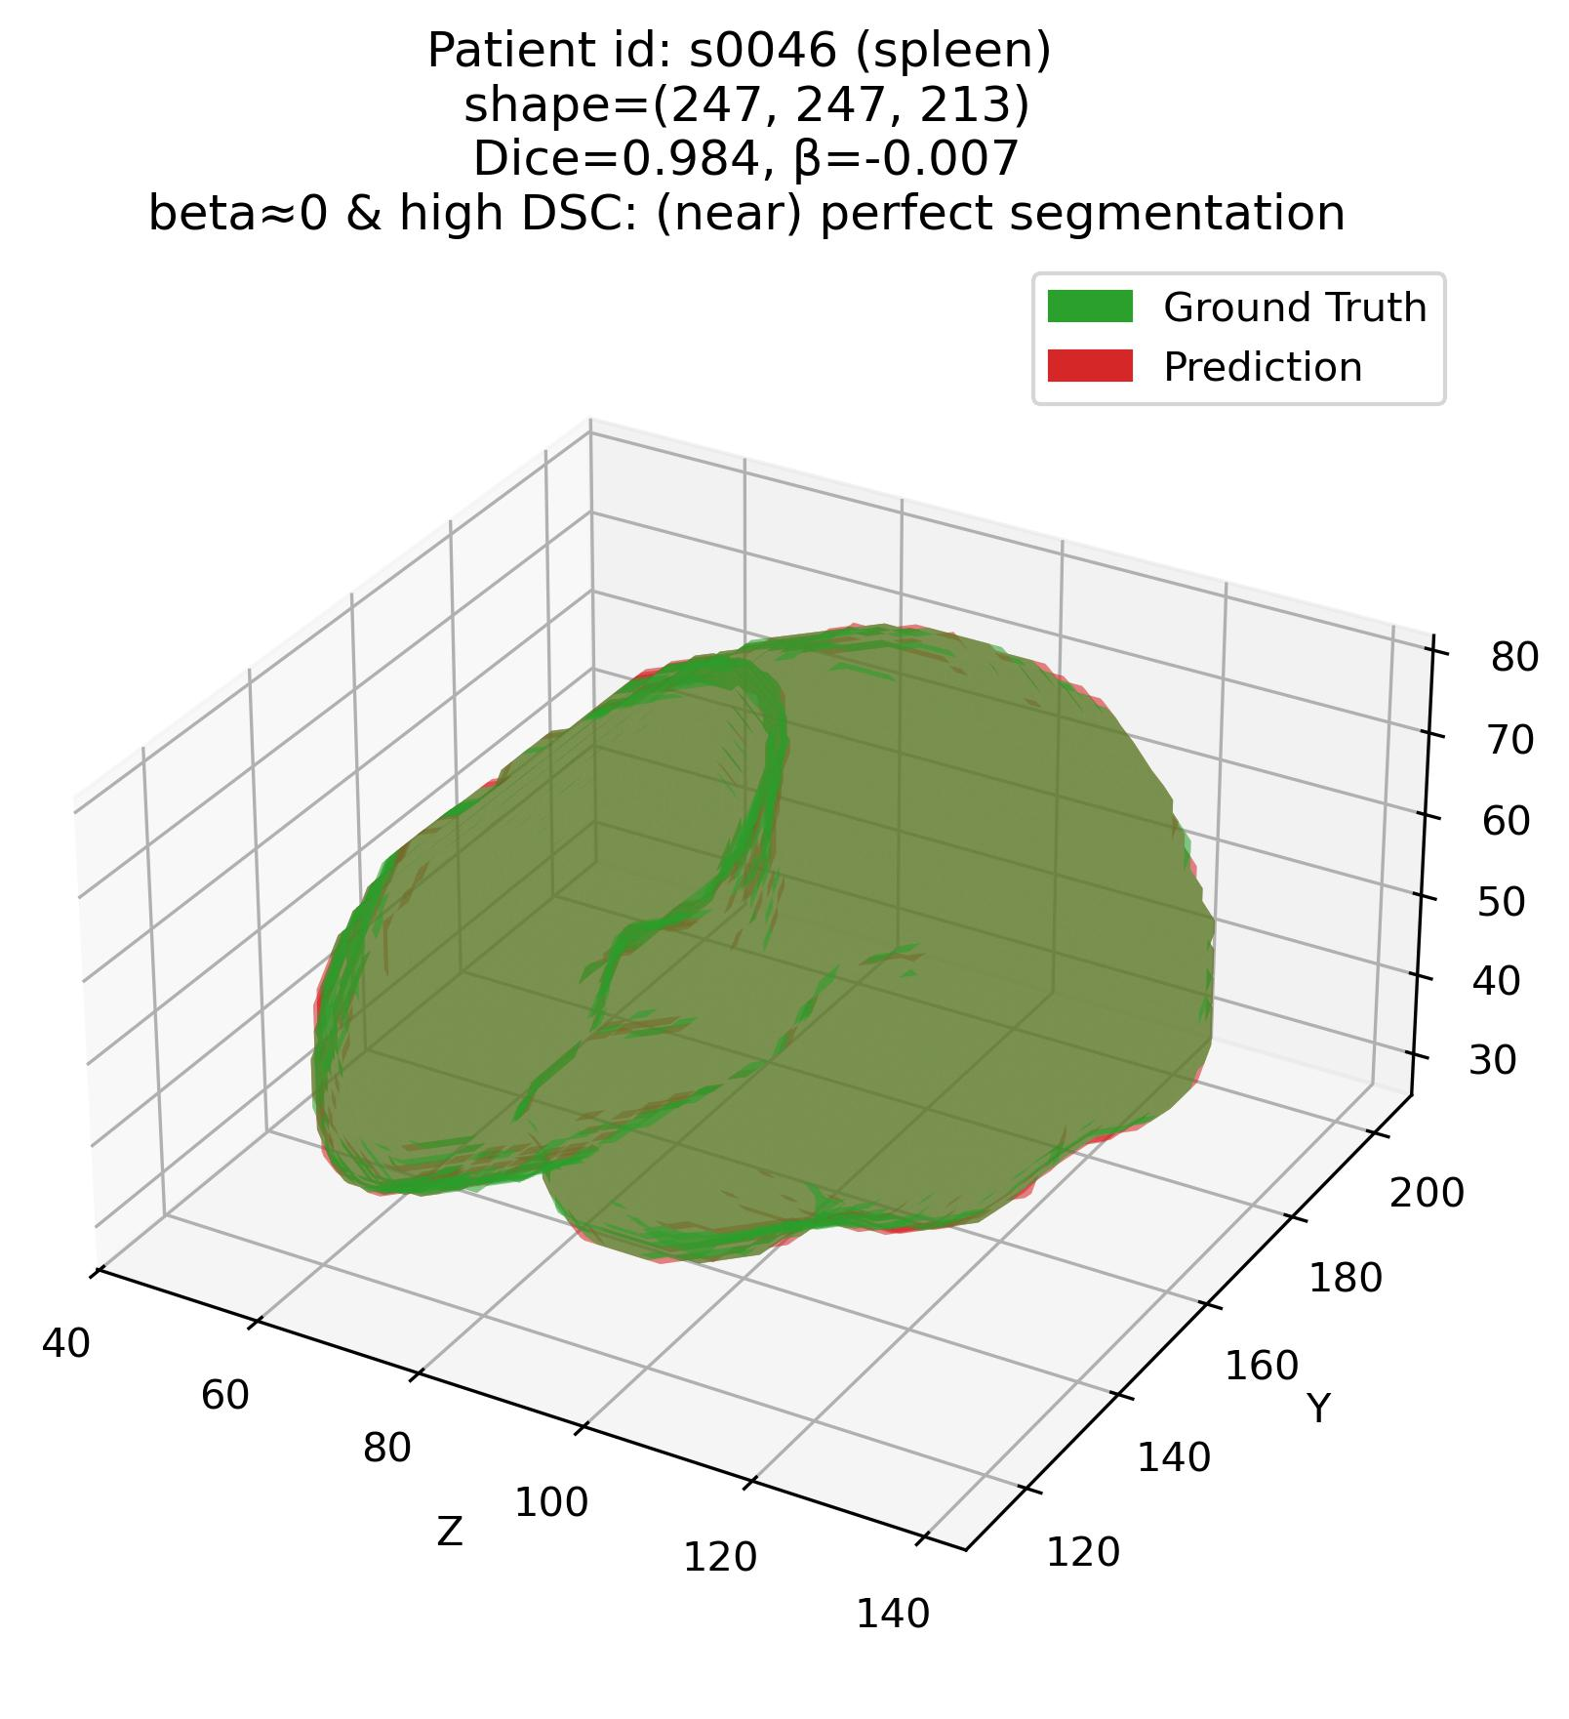
Error characterization protocol
The analysis framework – Q1
Q1: Some examples – 2. Spleen (Easy – high DSC organ)

Slide 16
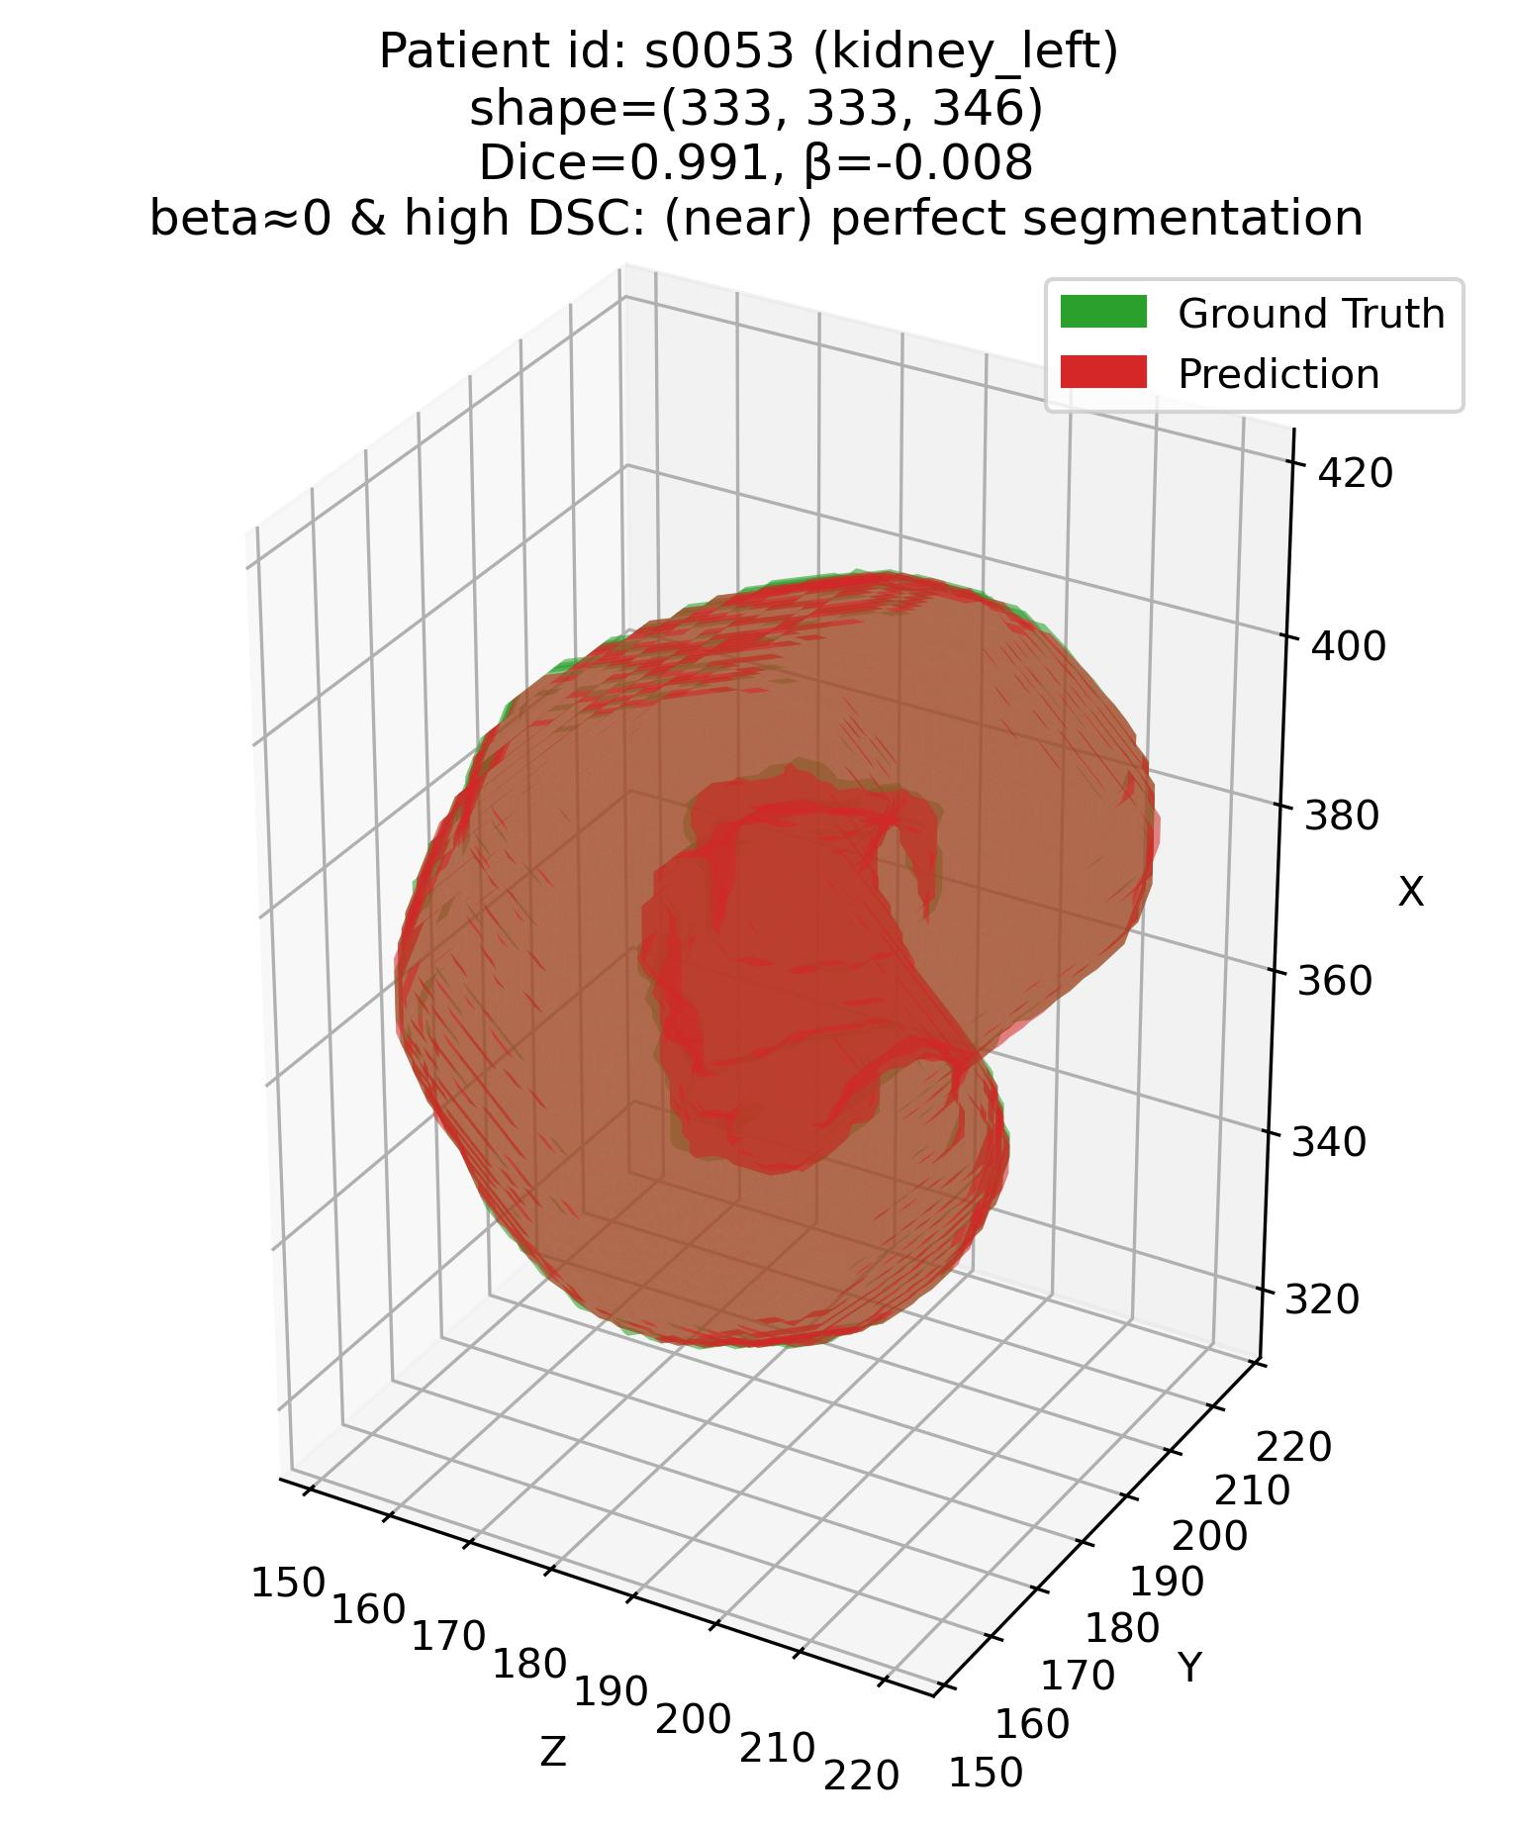
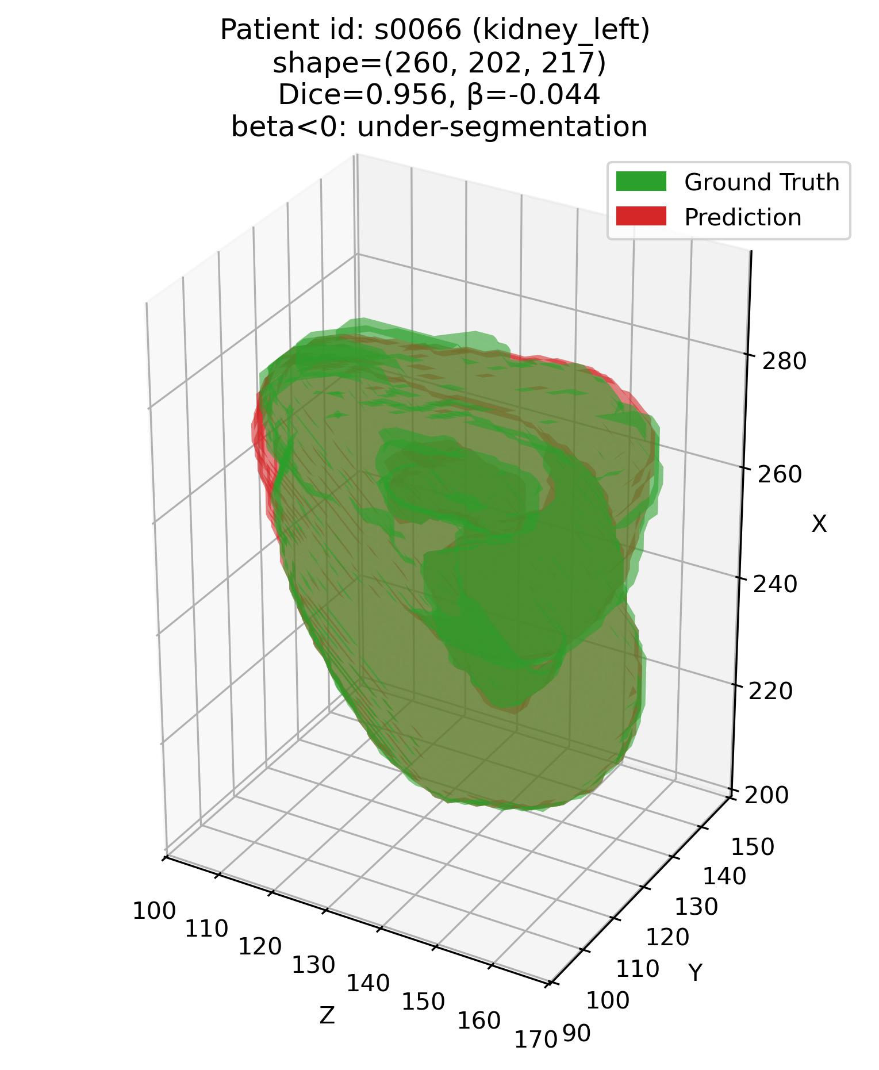
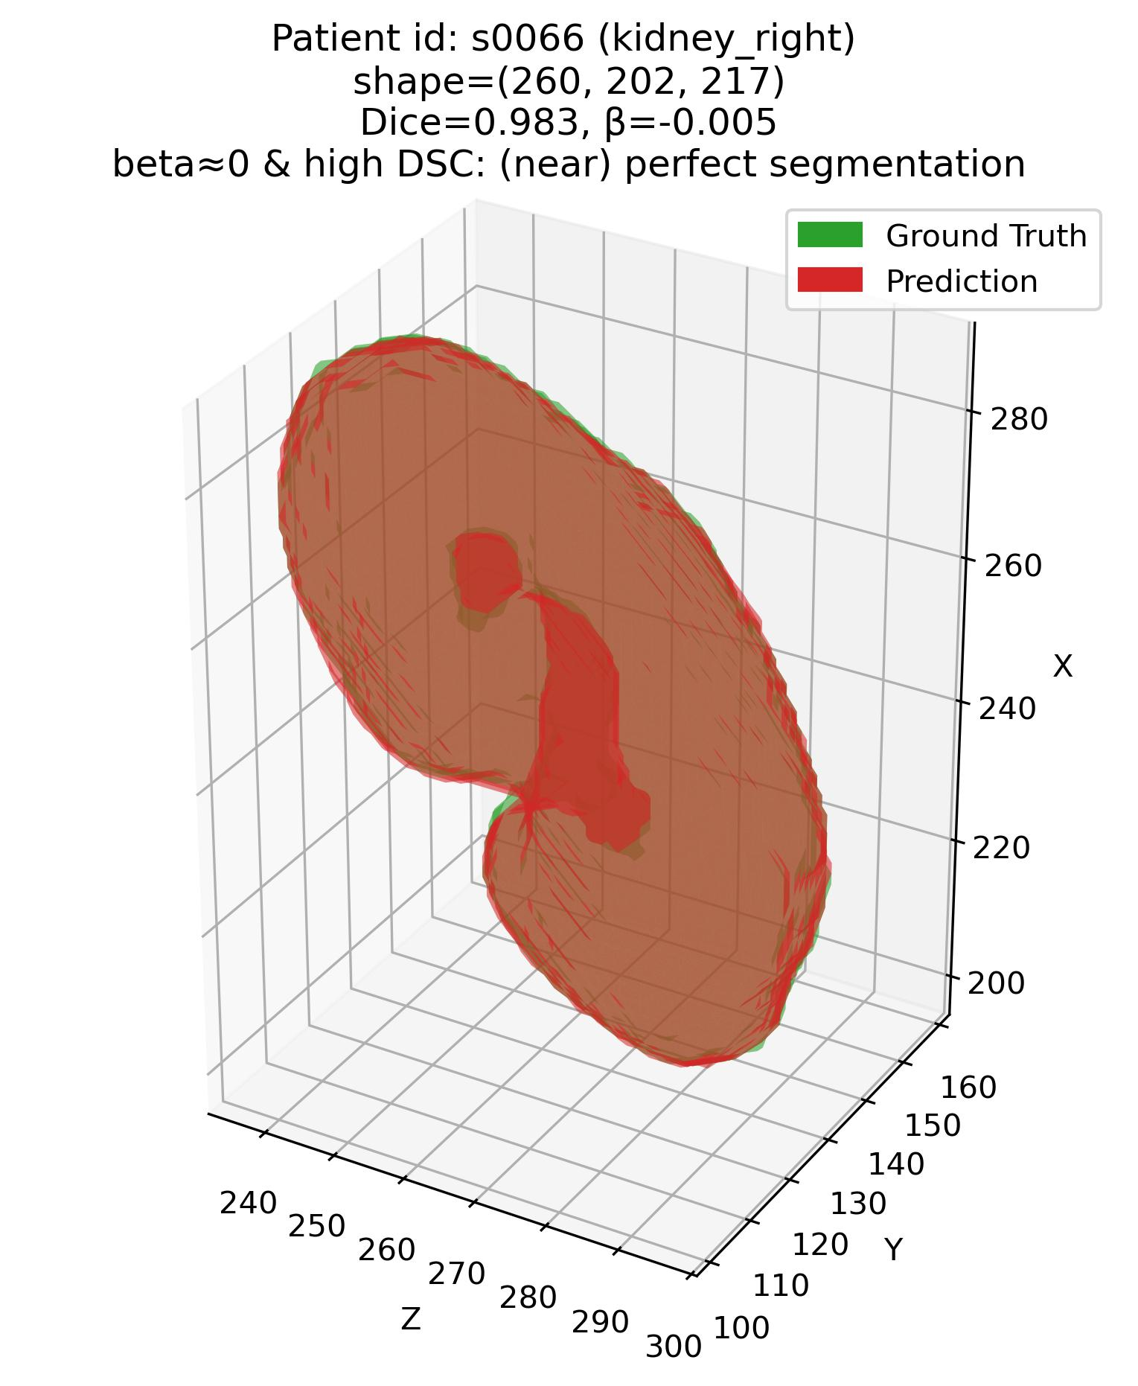
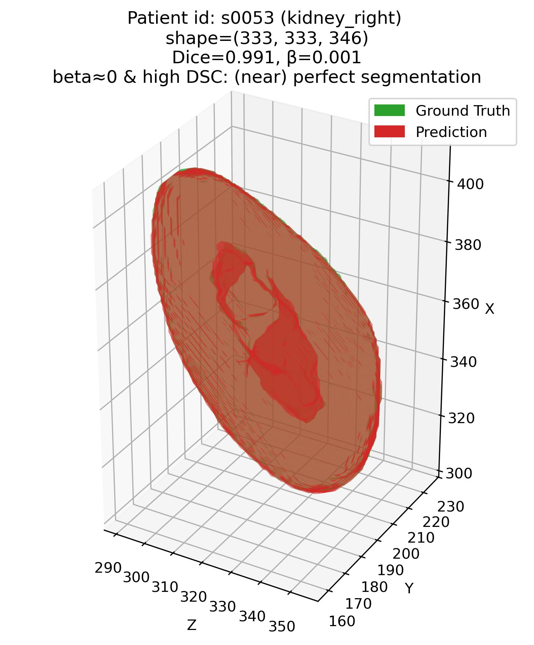
Error characterization protocol
The analysis framework – Q1
Q1: Some examples – 3. Kidneys (Easy – high DSC organ)
Patient# s0053 (Kidneys)
Patient# s0066 (Kidneys)

Slide 17
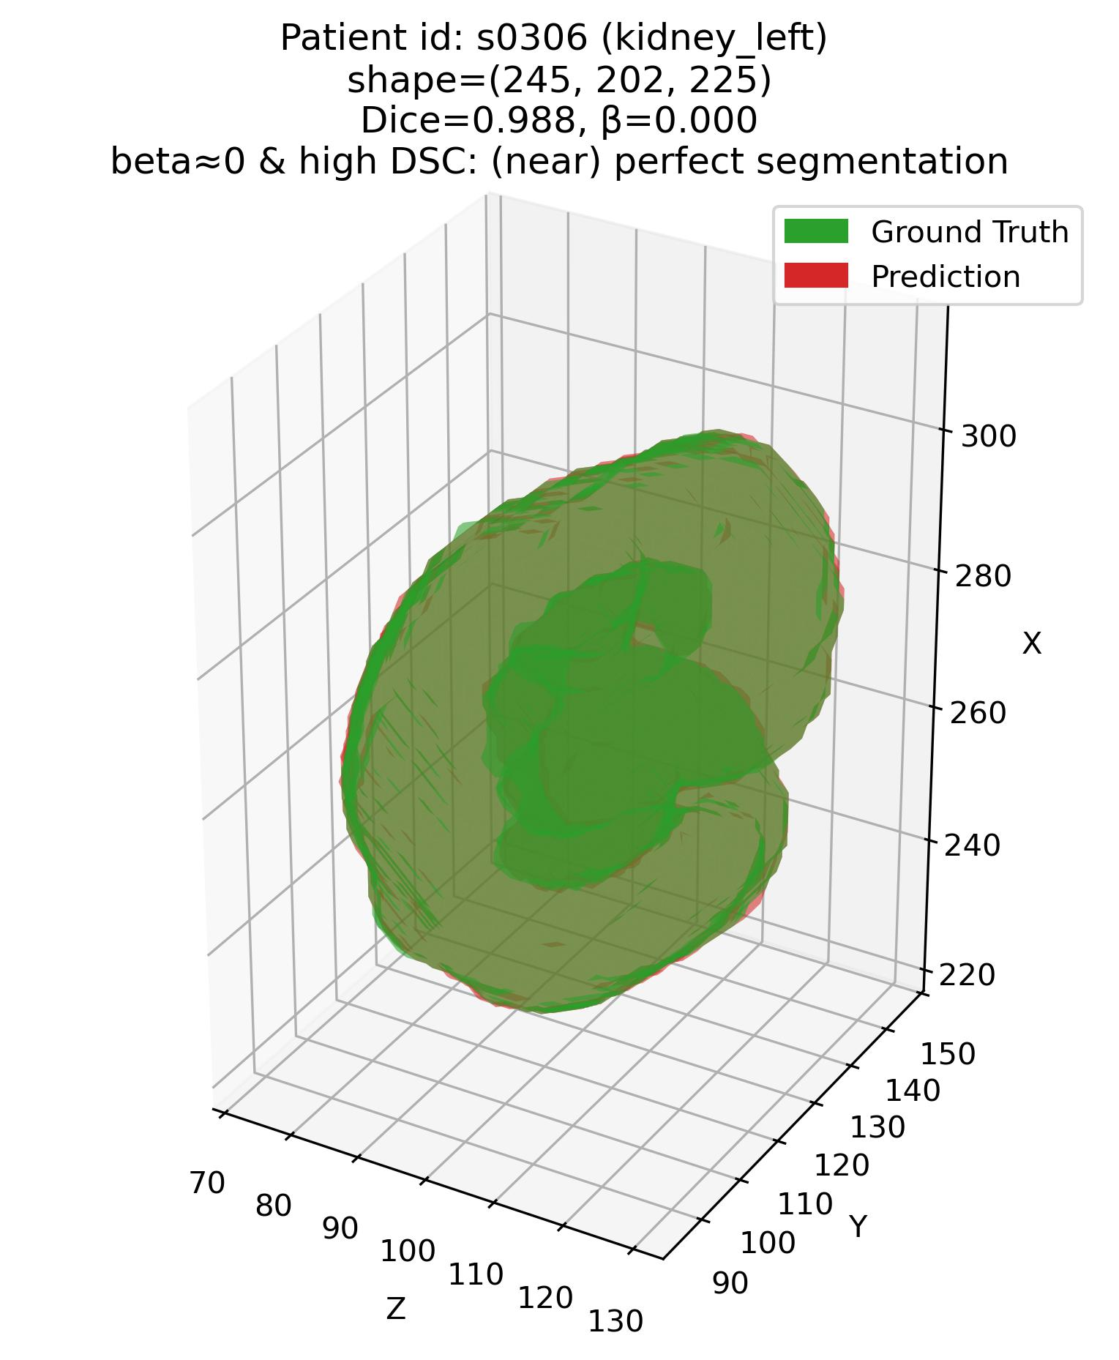
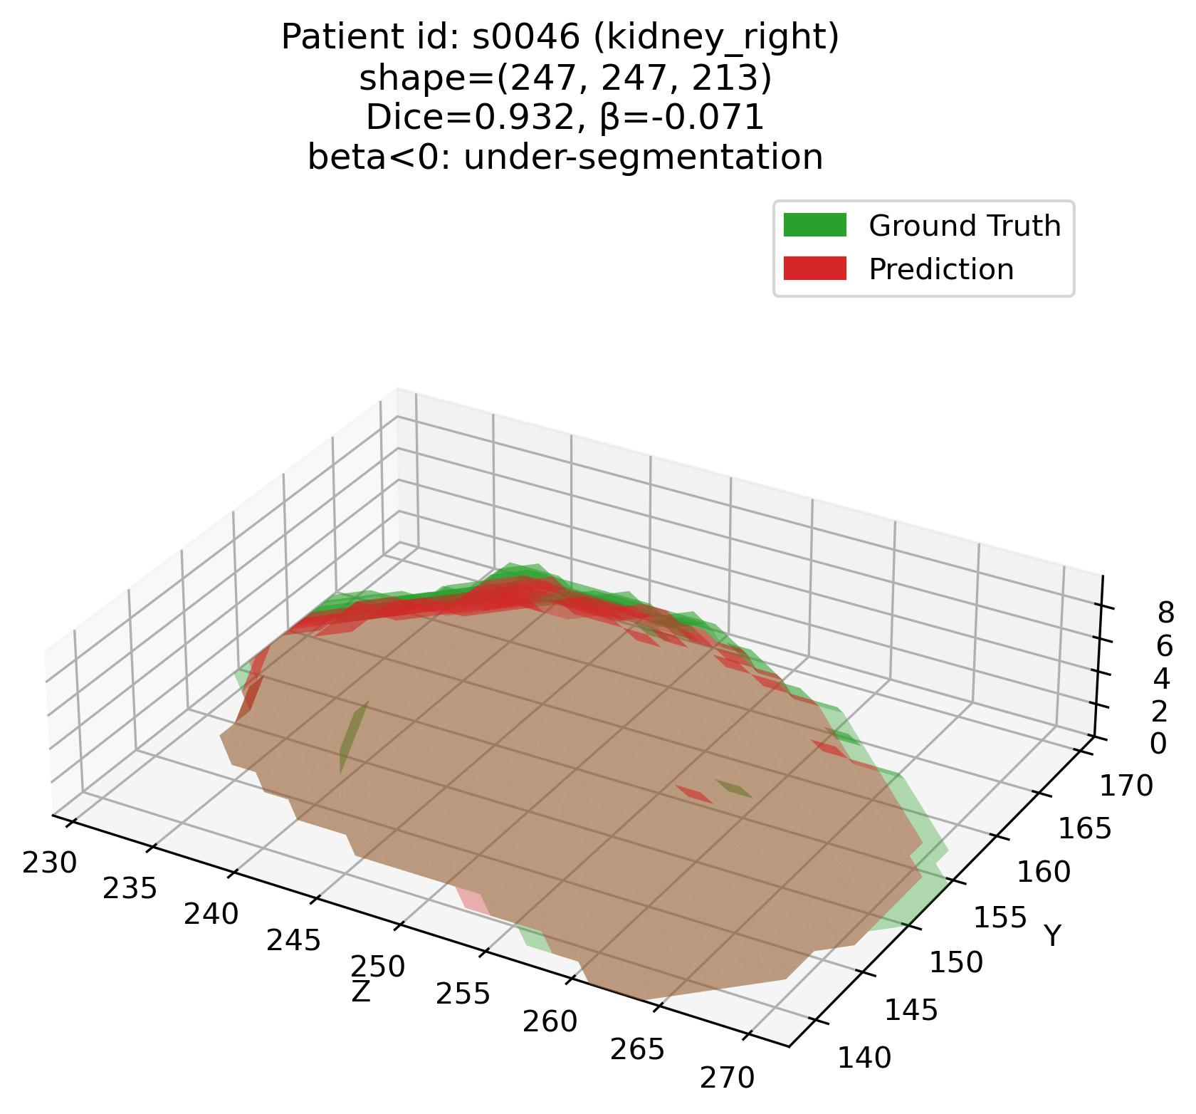
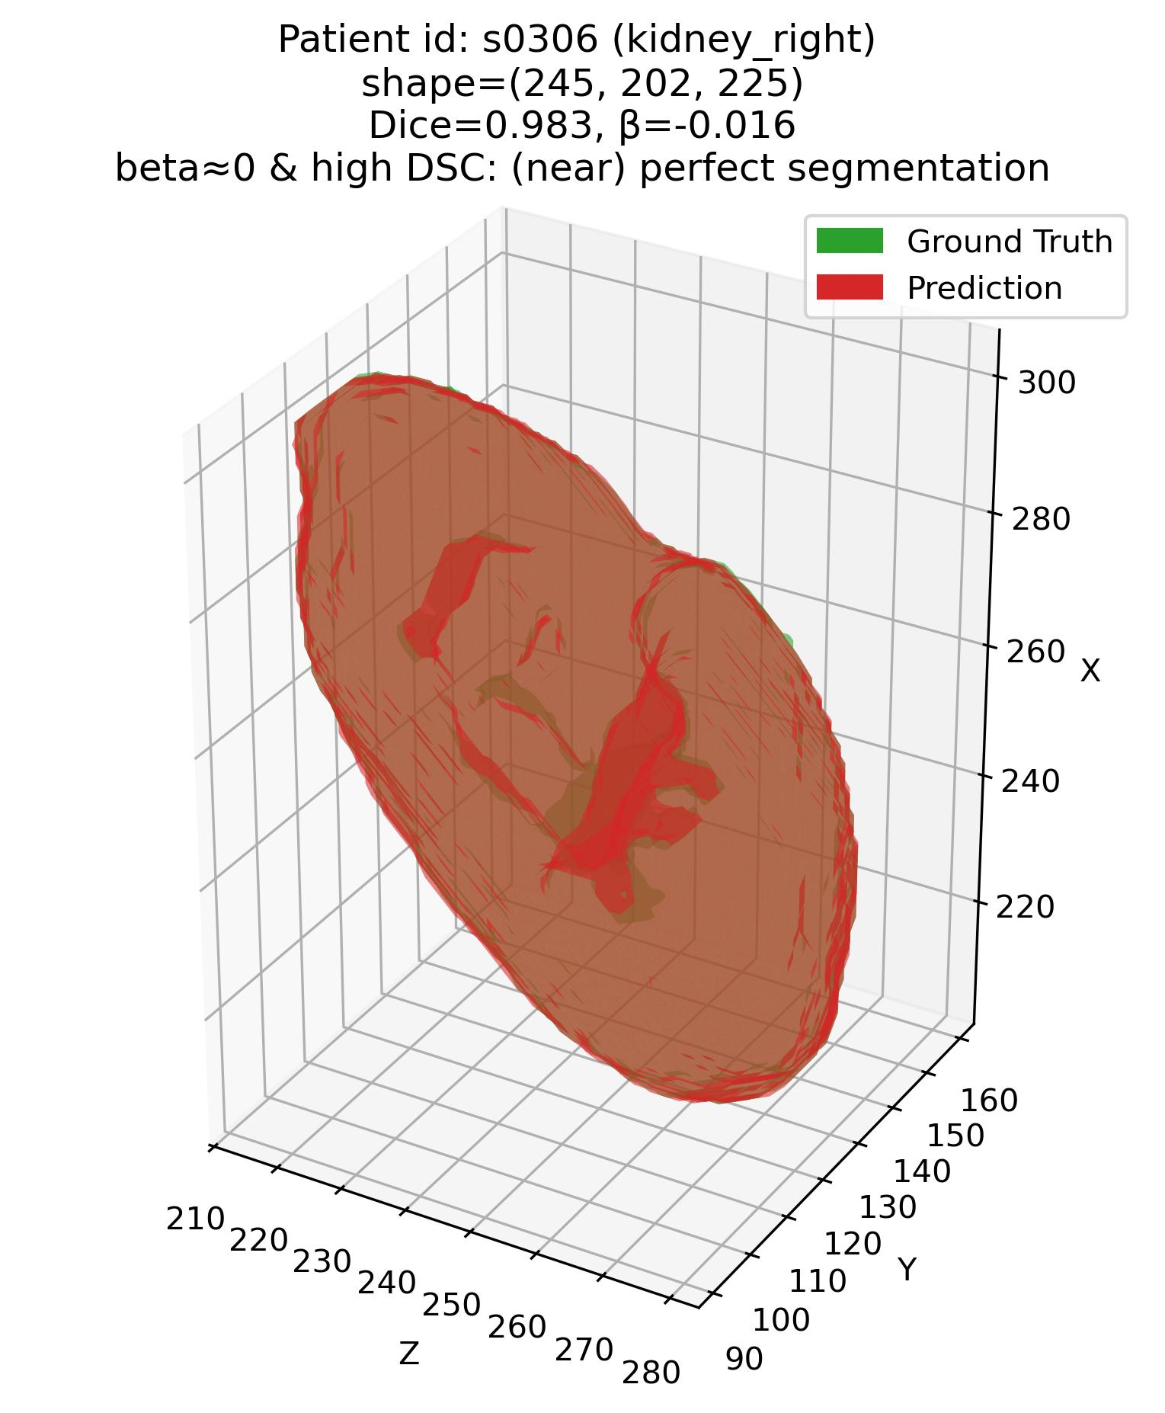
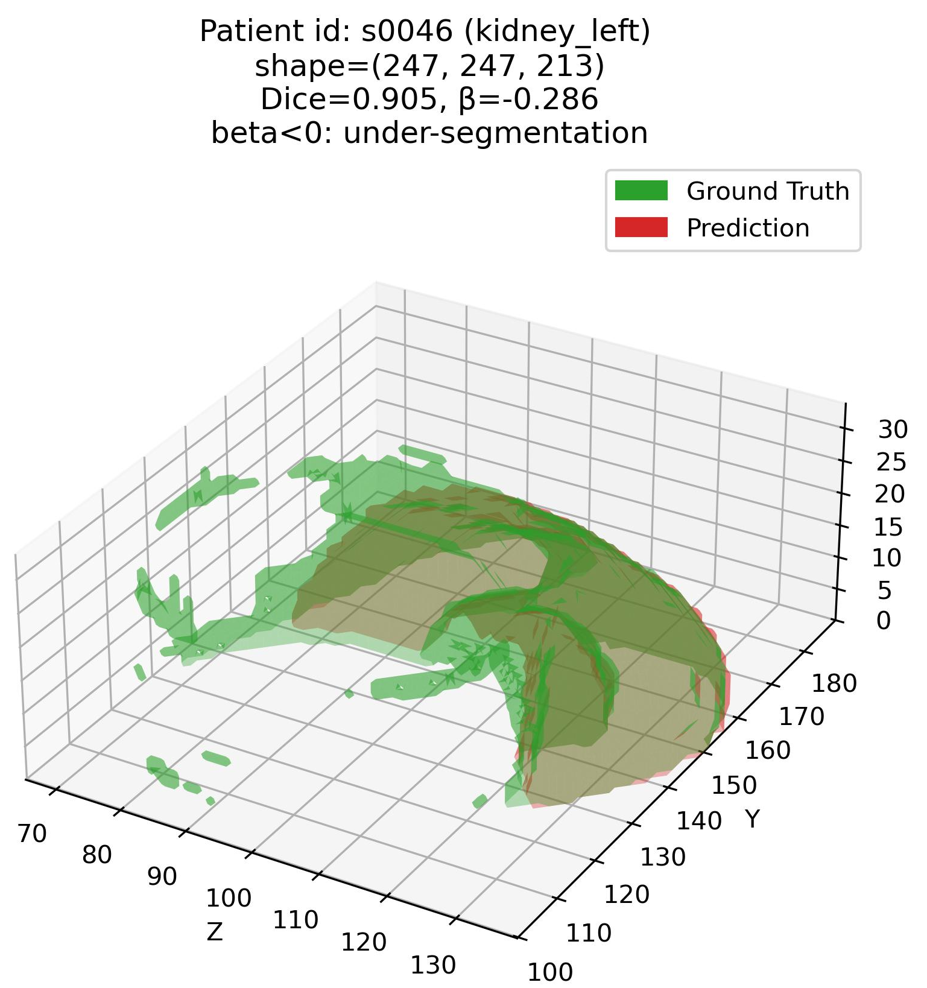
Error characterization protocol
The analysis framework – Q1
Q1: Some examples – 3. Kidneys (Easy – high DSC organ)
Patient# s0306 (Kidneys)
Patient# s0046 (Kidneys)

Slide 18
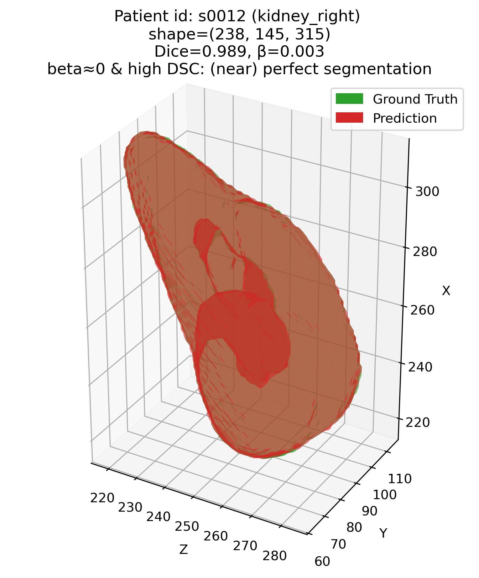
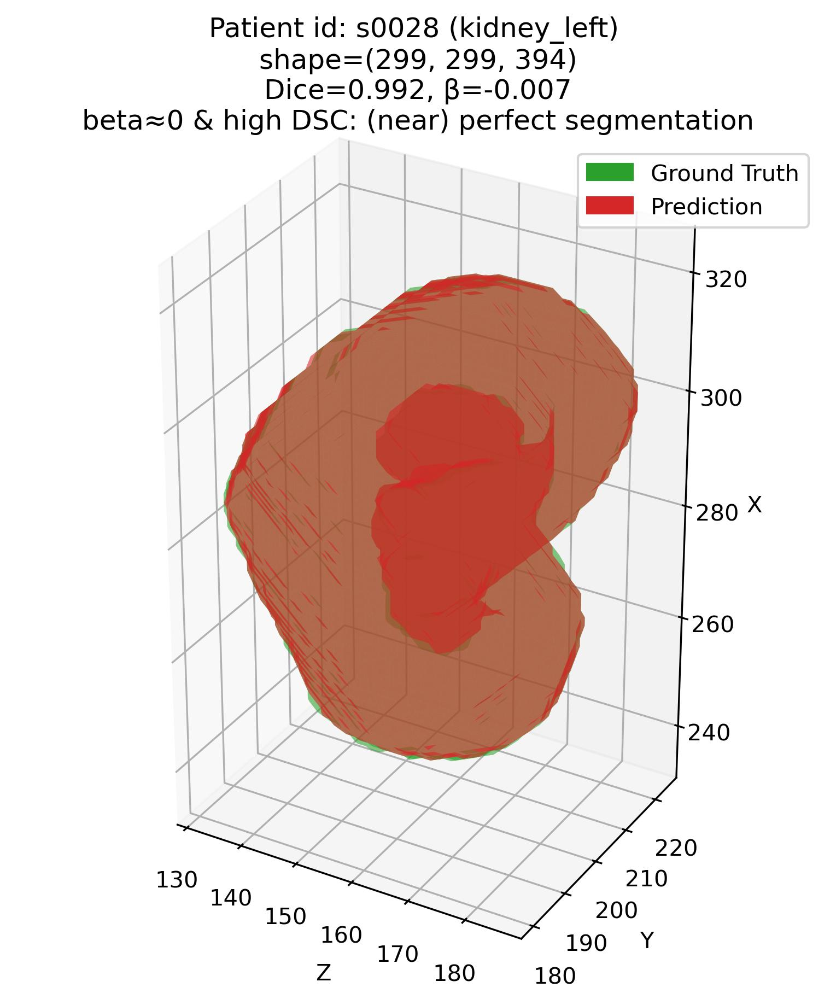
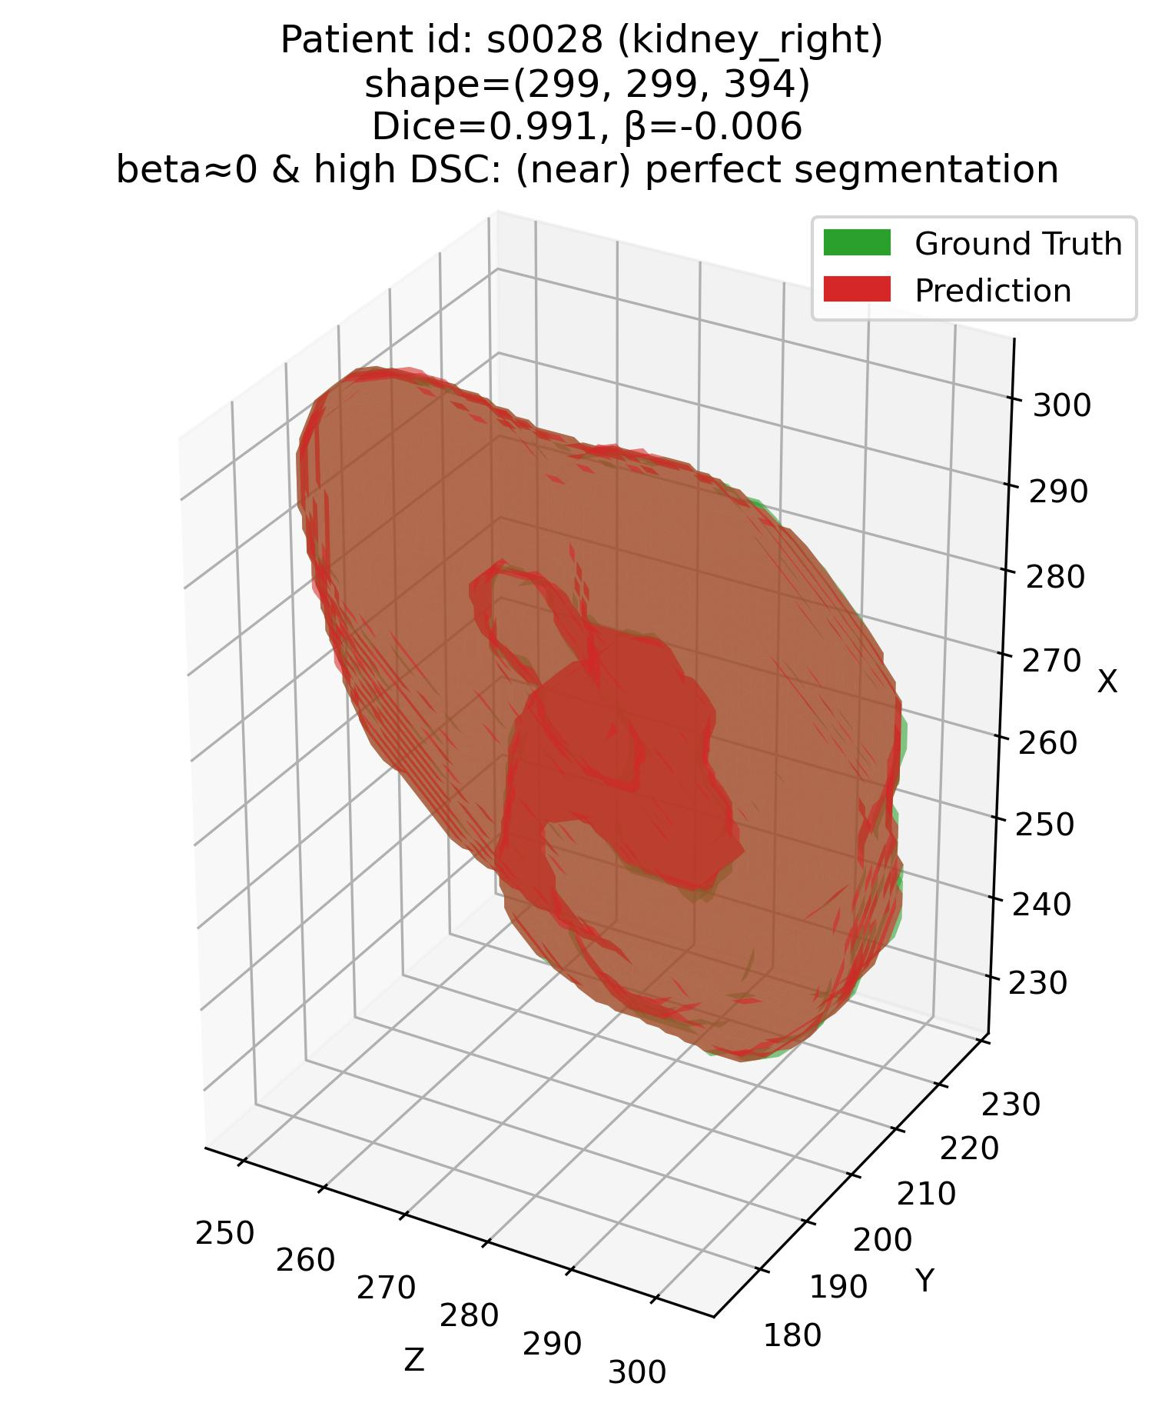
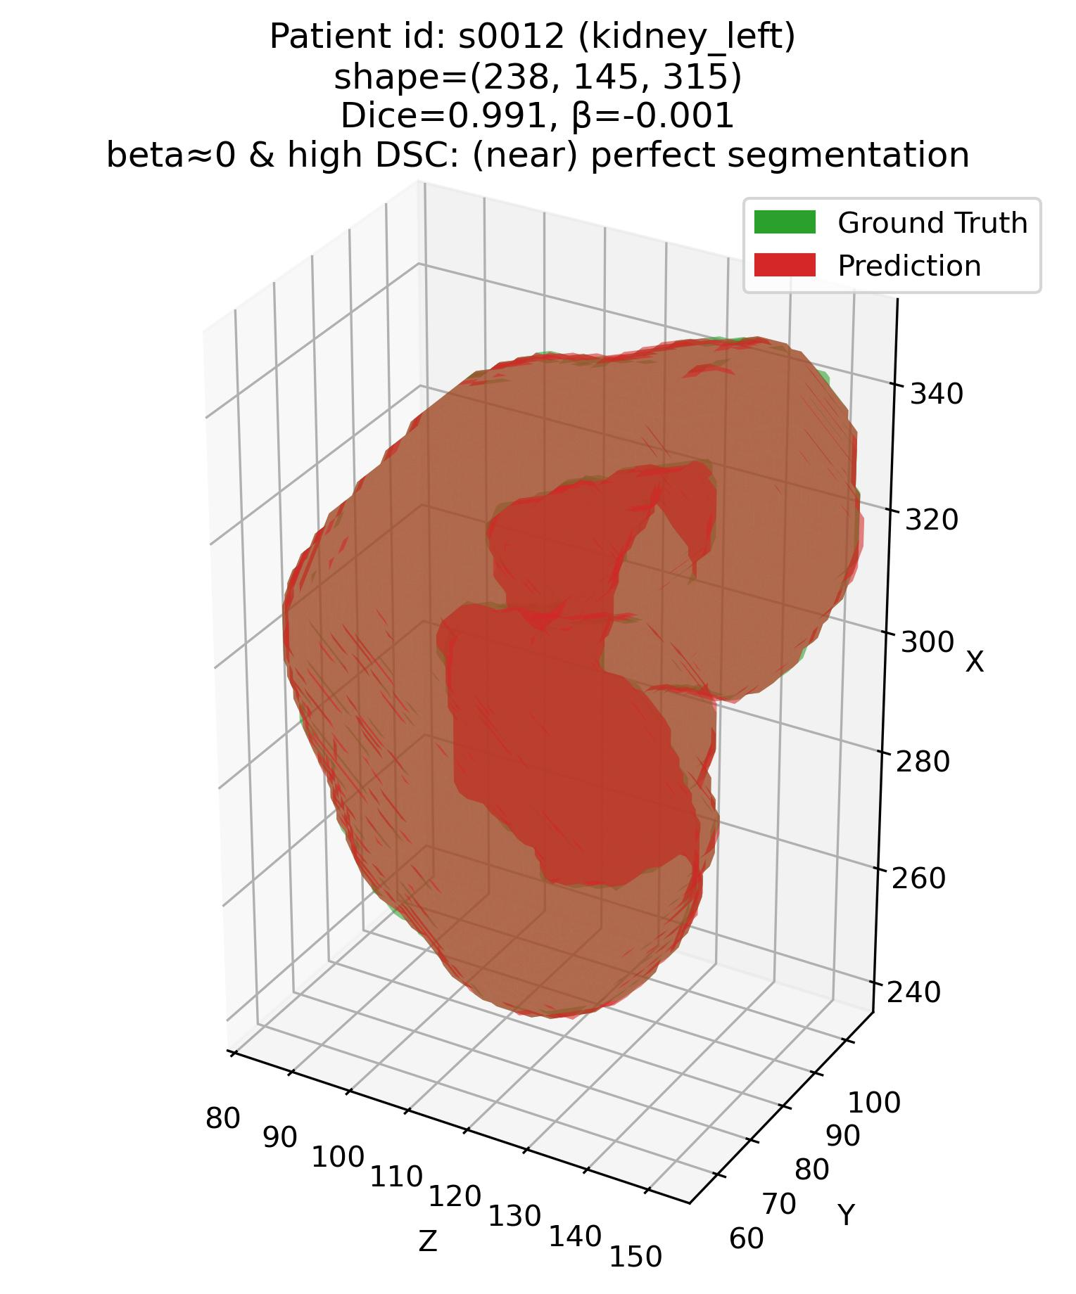
Error characterization protocol
The analysis framework – Q1
Q1: Some examples – 3. Kidneys (Easy – high DSC organ)
Patient# s0012 (Kidneys)
Patient# s0028 (Kidneys)

Slide 19
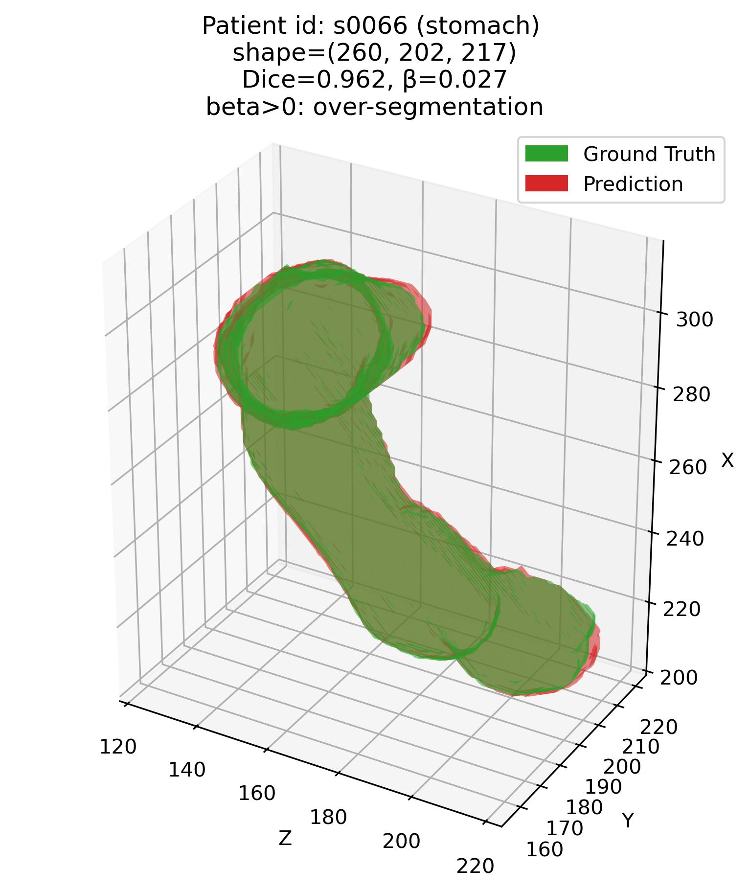
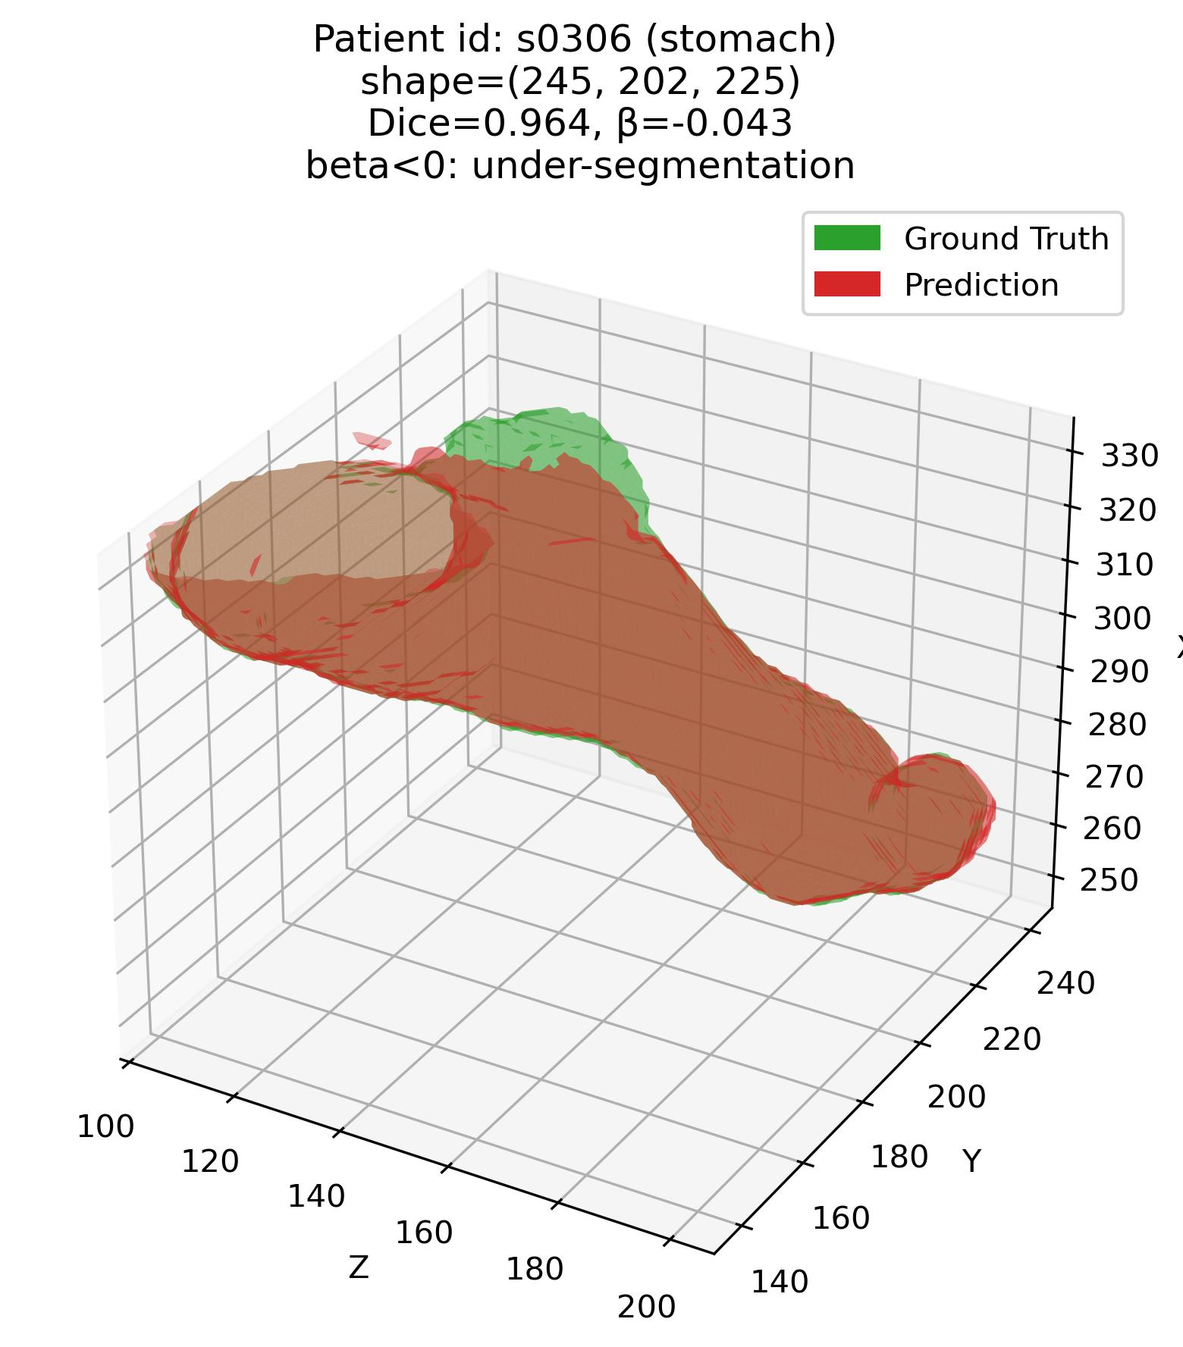
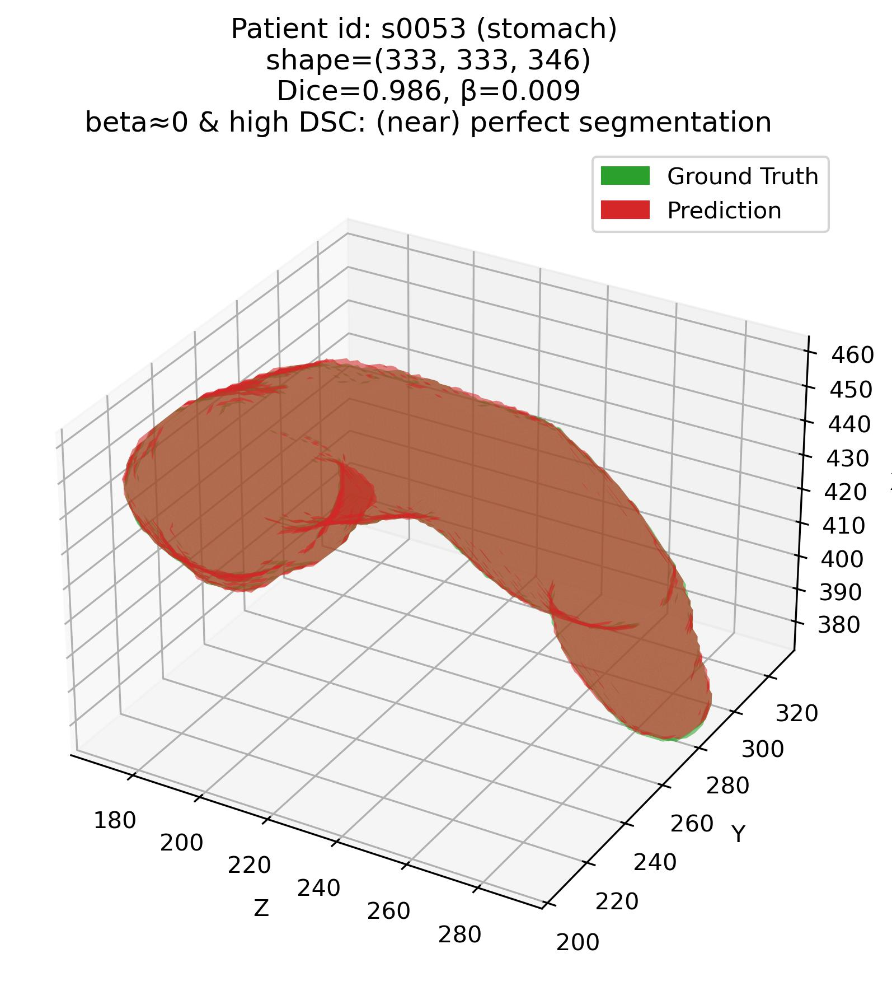
Error characterization protocol
The analysis framework – Q1
Q1: Some examples – 4. Stomach (Moderate – average DSC organ)

Slide 20
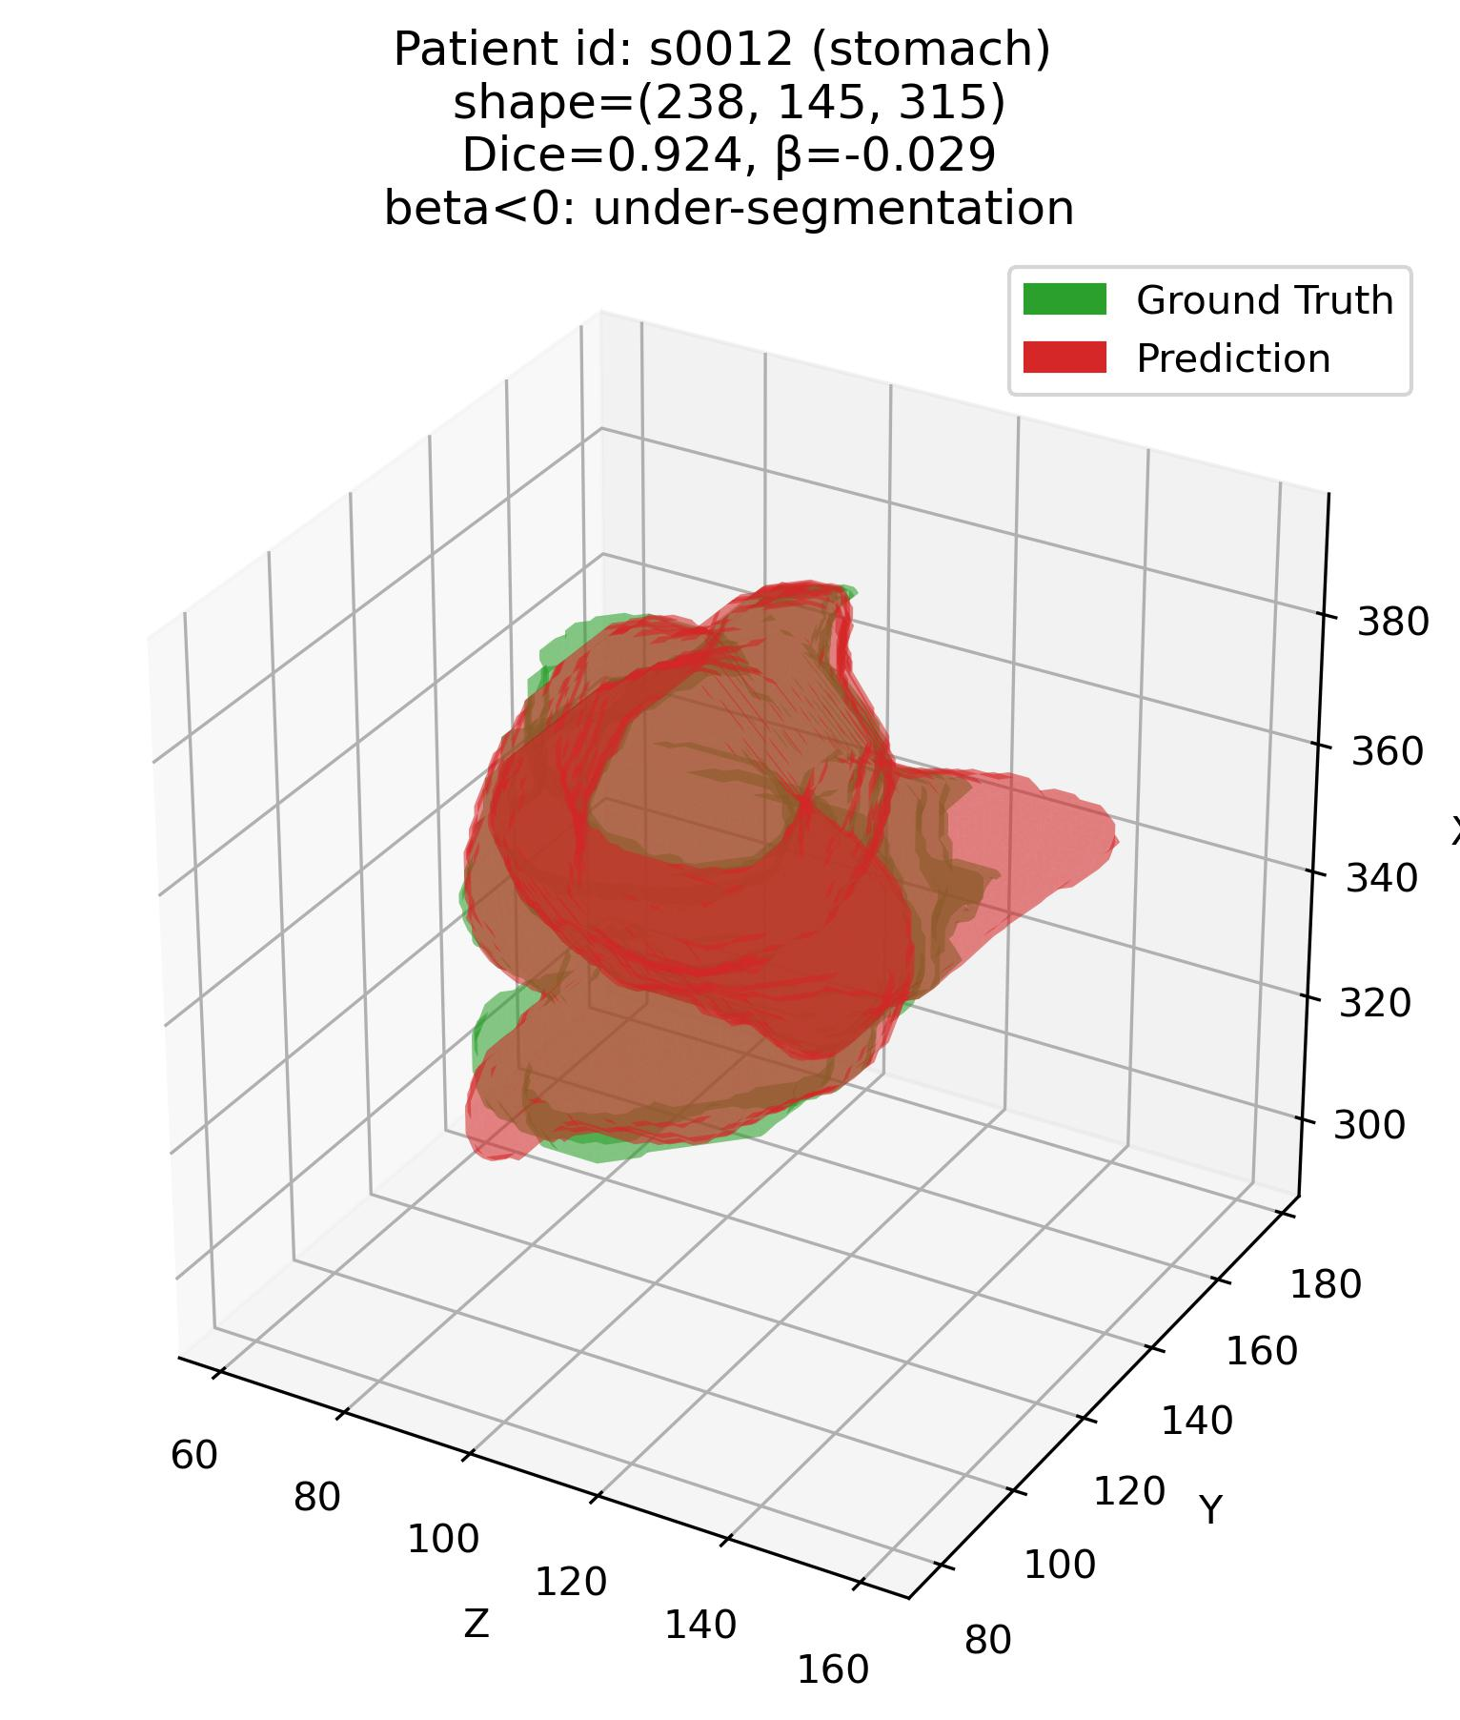
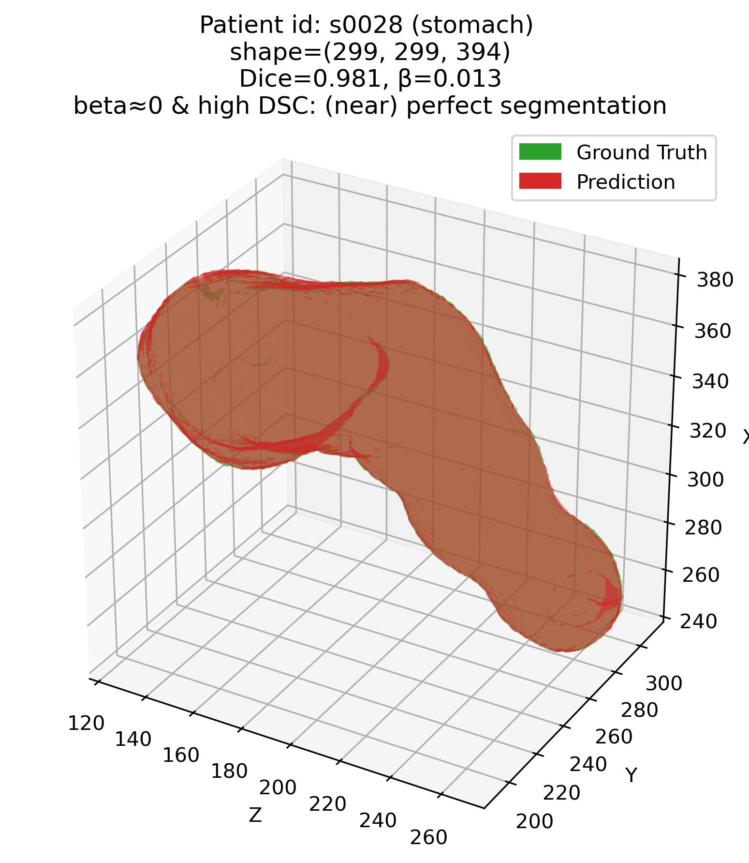
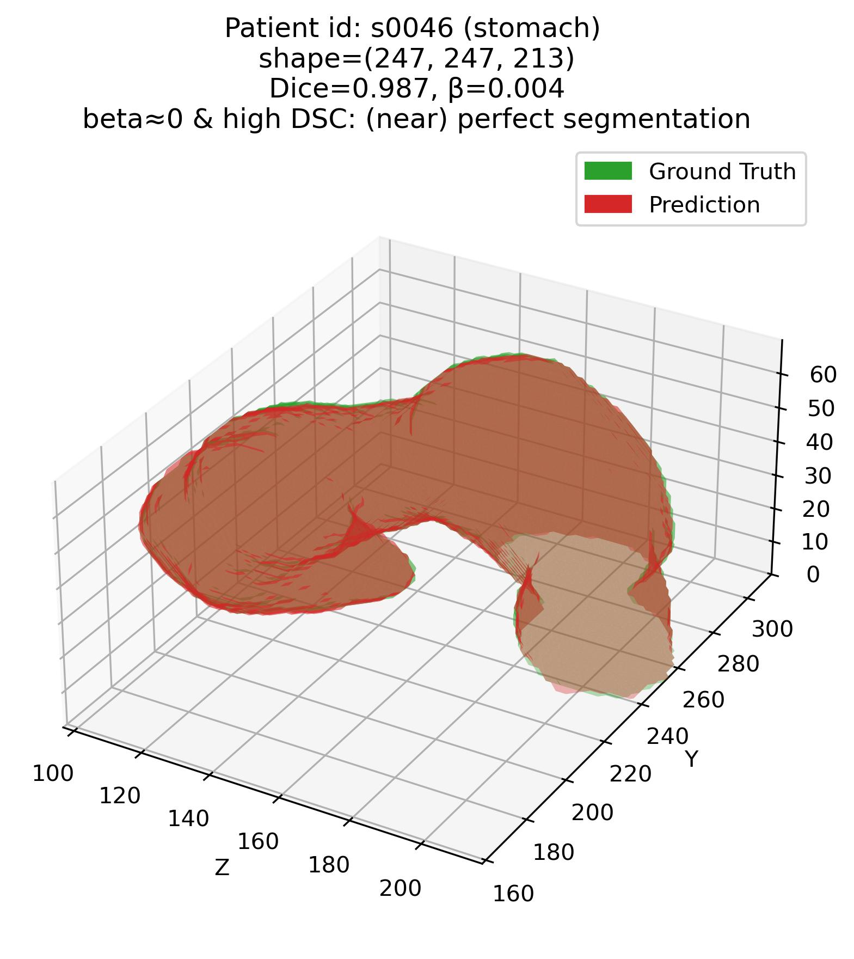
Error characterization protocol
The analysis framework – Q1
Q1: Some examples – 4. Stomach (Moderate – average DSC organ)

Slide 21
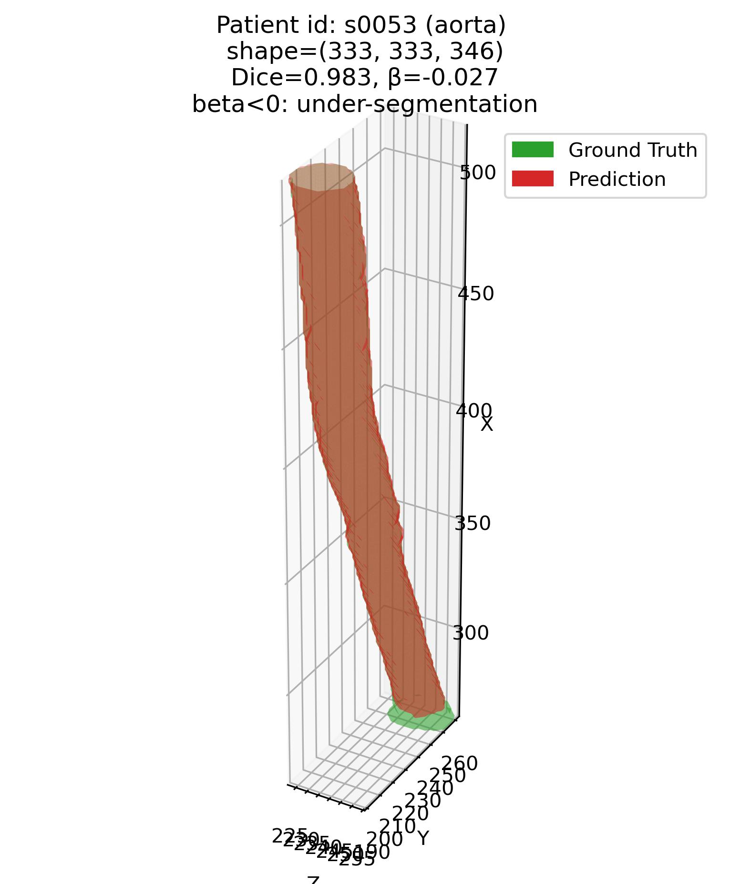
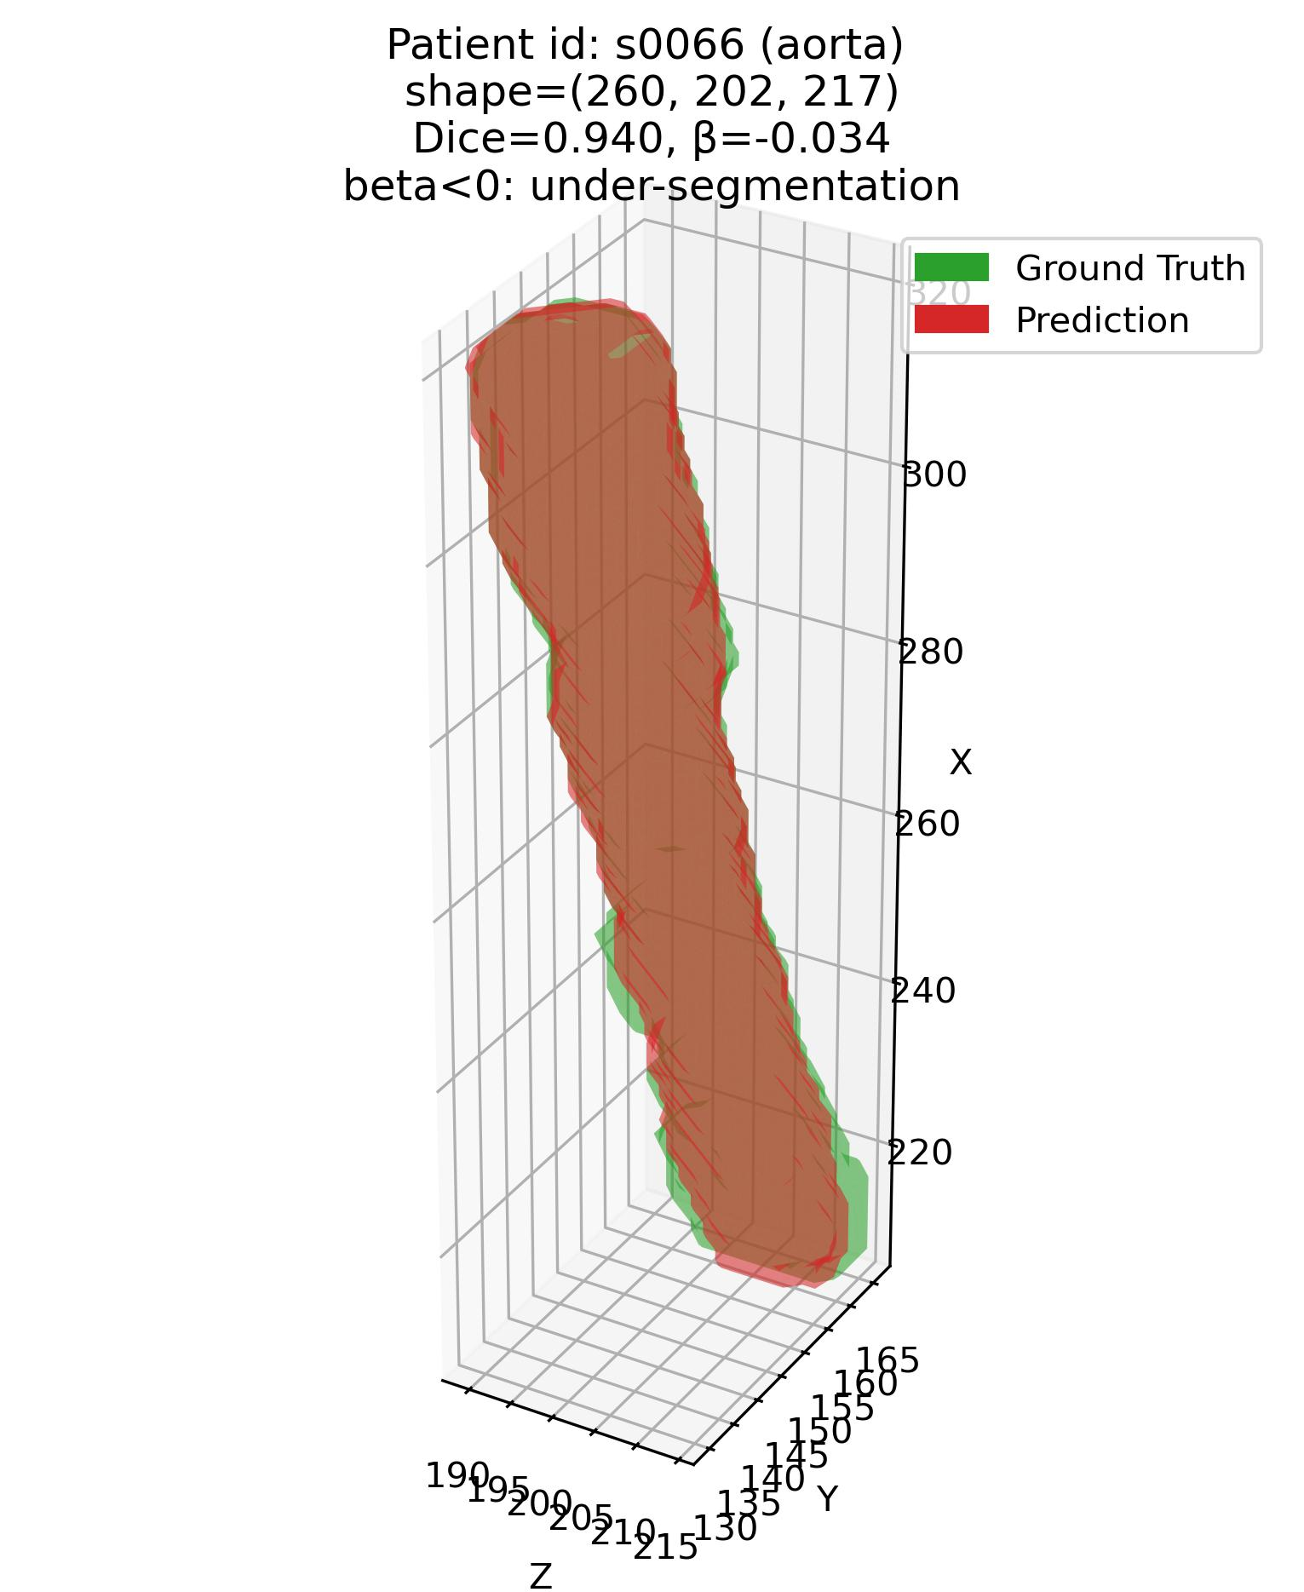
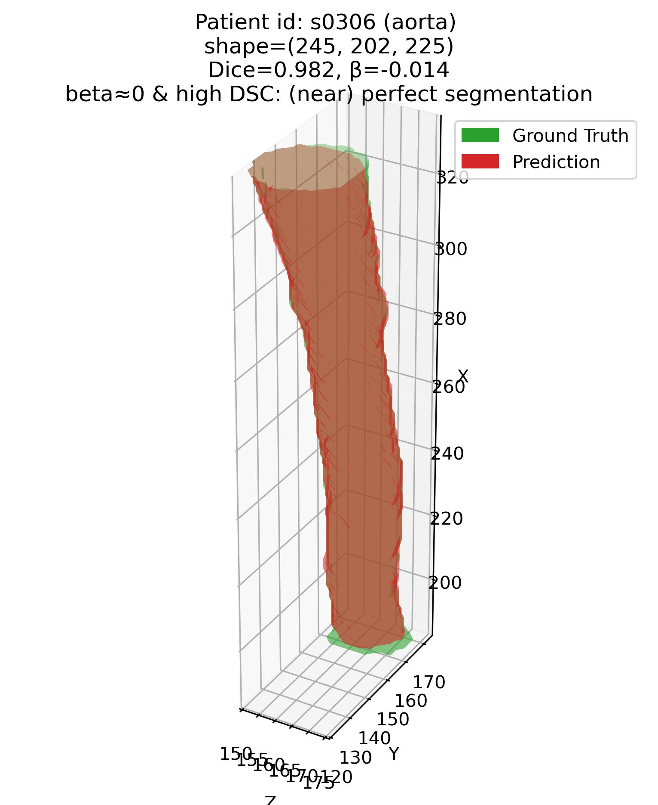
Error characterization protocol
The analysis framework – Q1
Q1: Some examples – 5. Aorta (Moderate – average DSC organ)

Slide 22
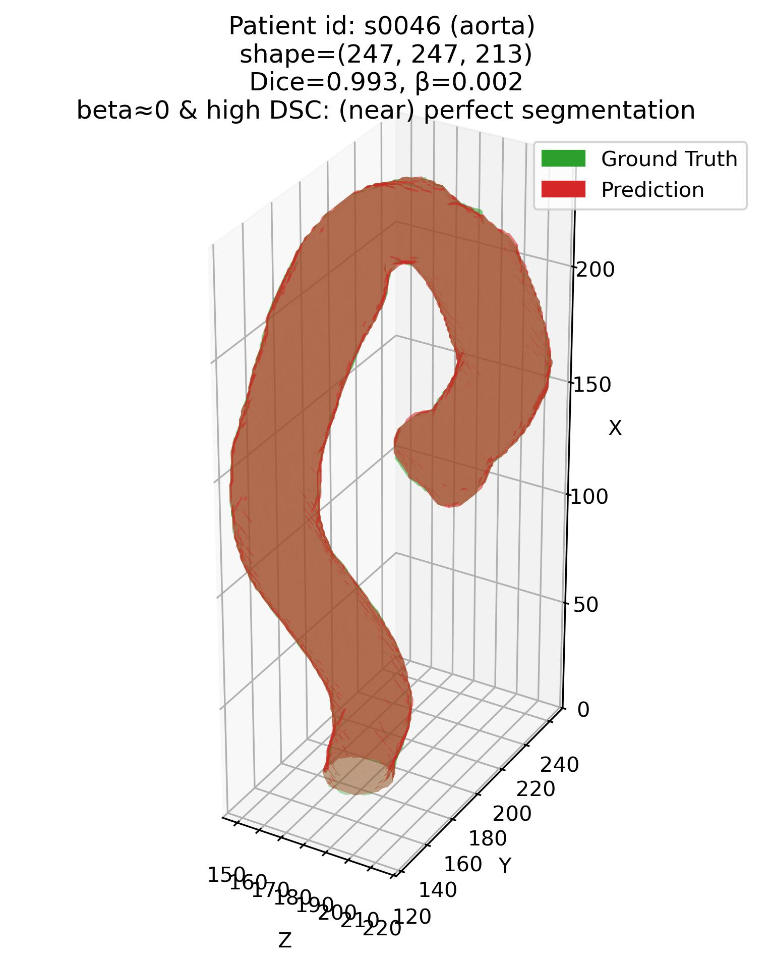
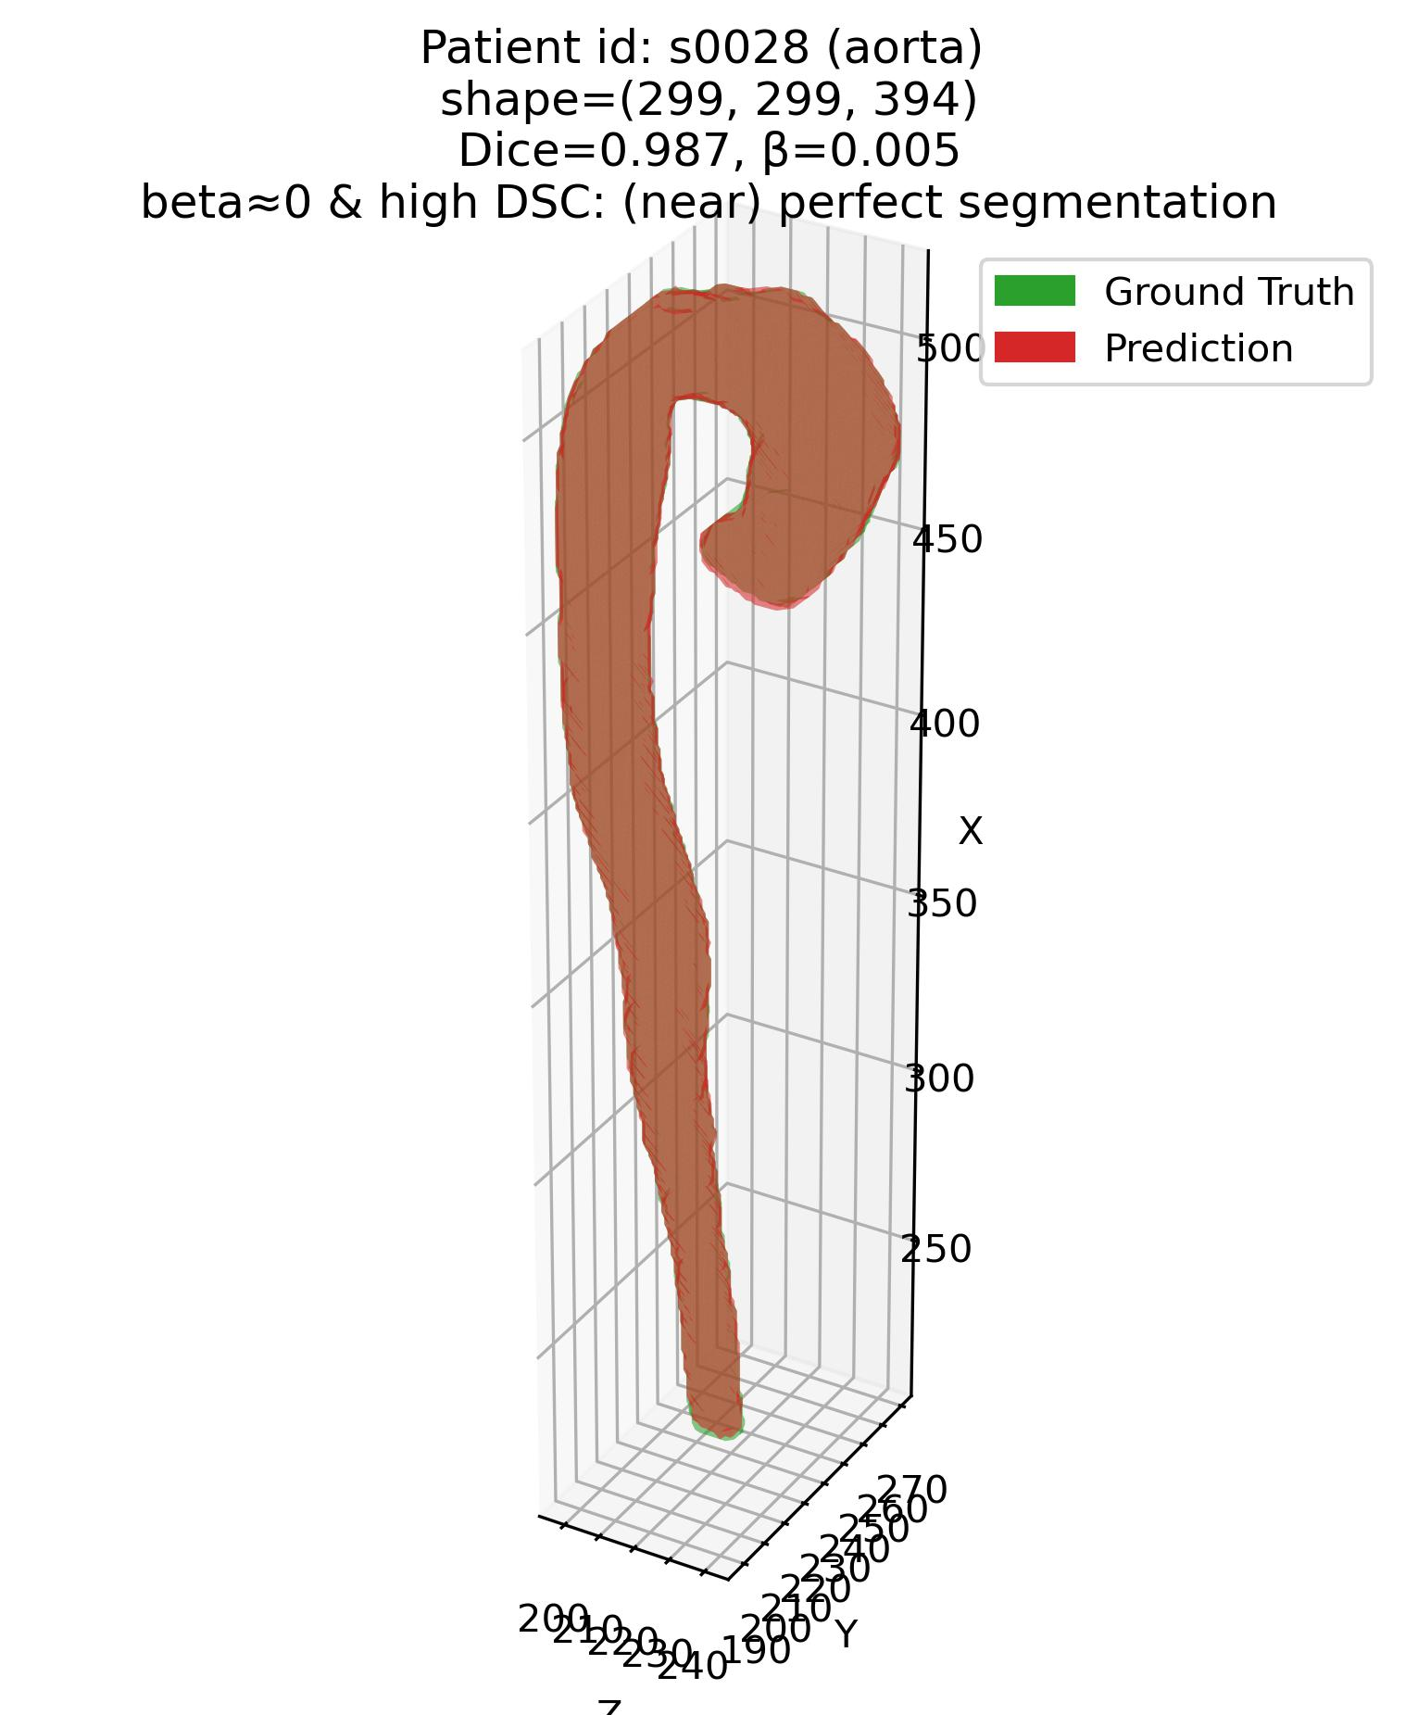
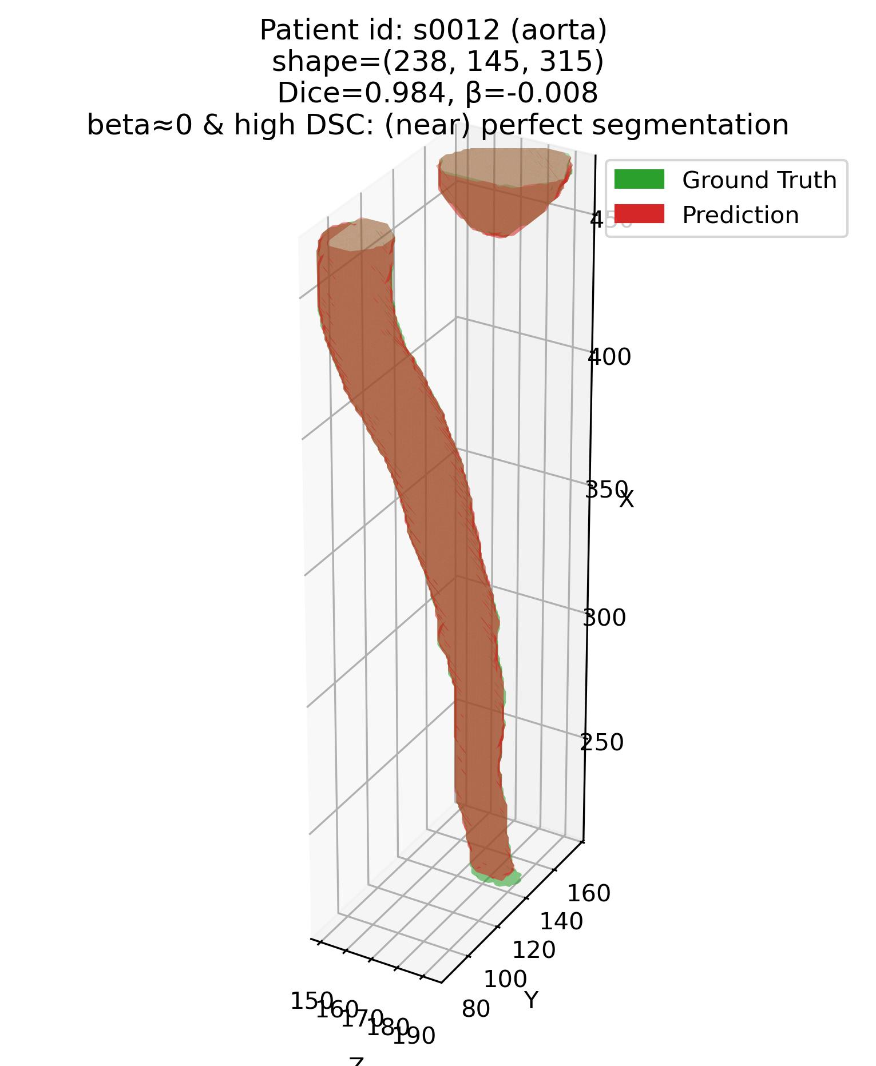
Error characterization protocol
The analysis framework – Q1
Q1: Some examples – 5. Aorta (Moderate – average DSC organ)

Slide 23
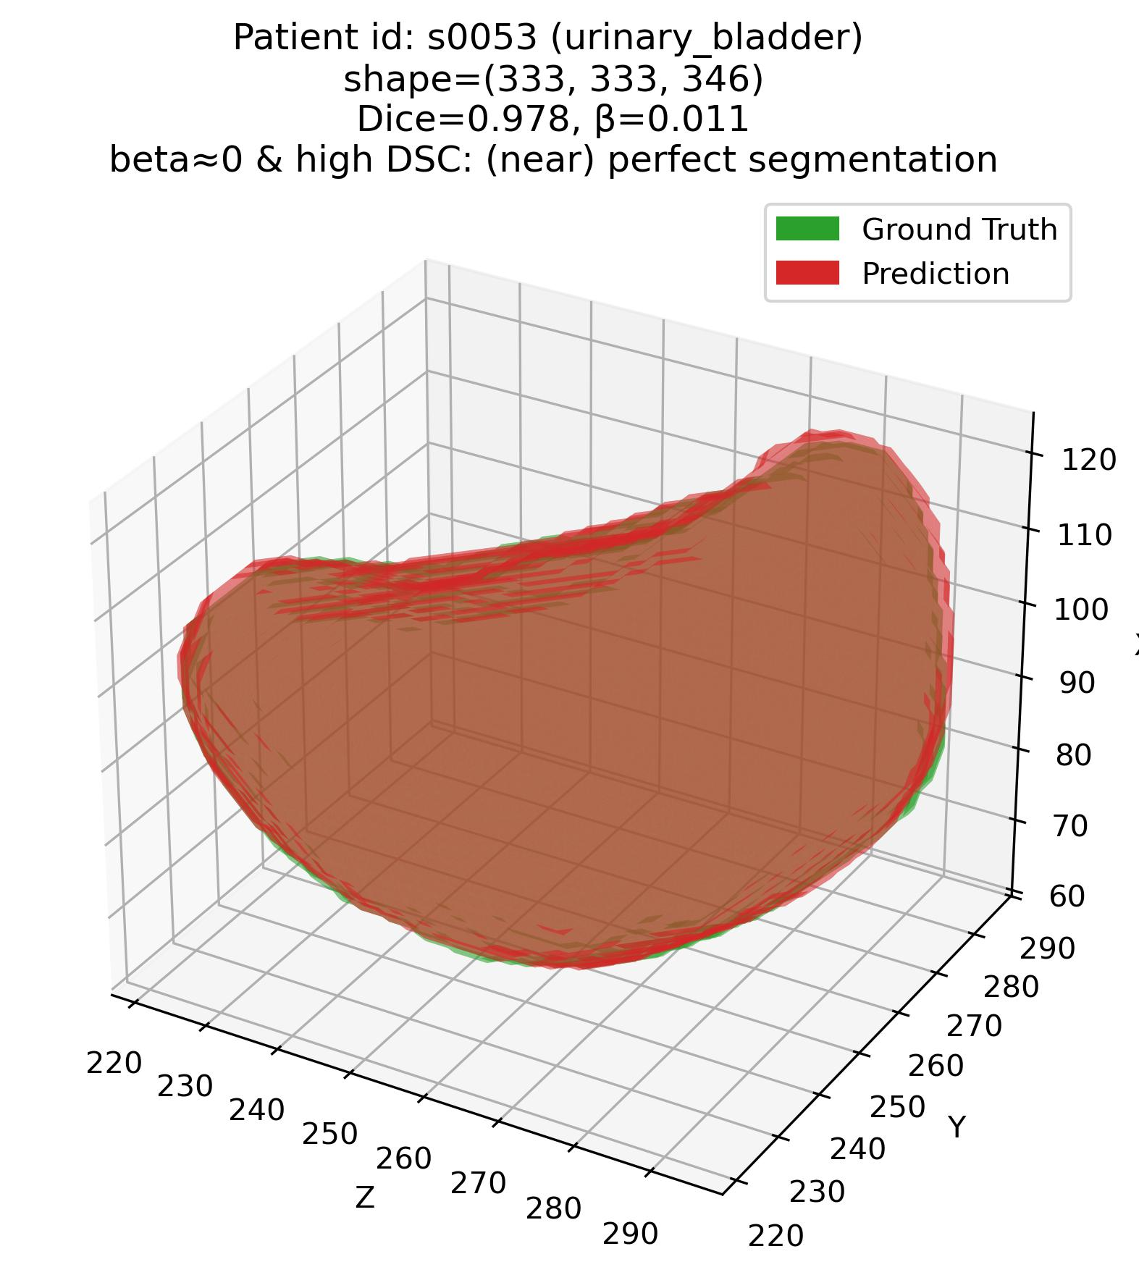
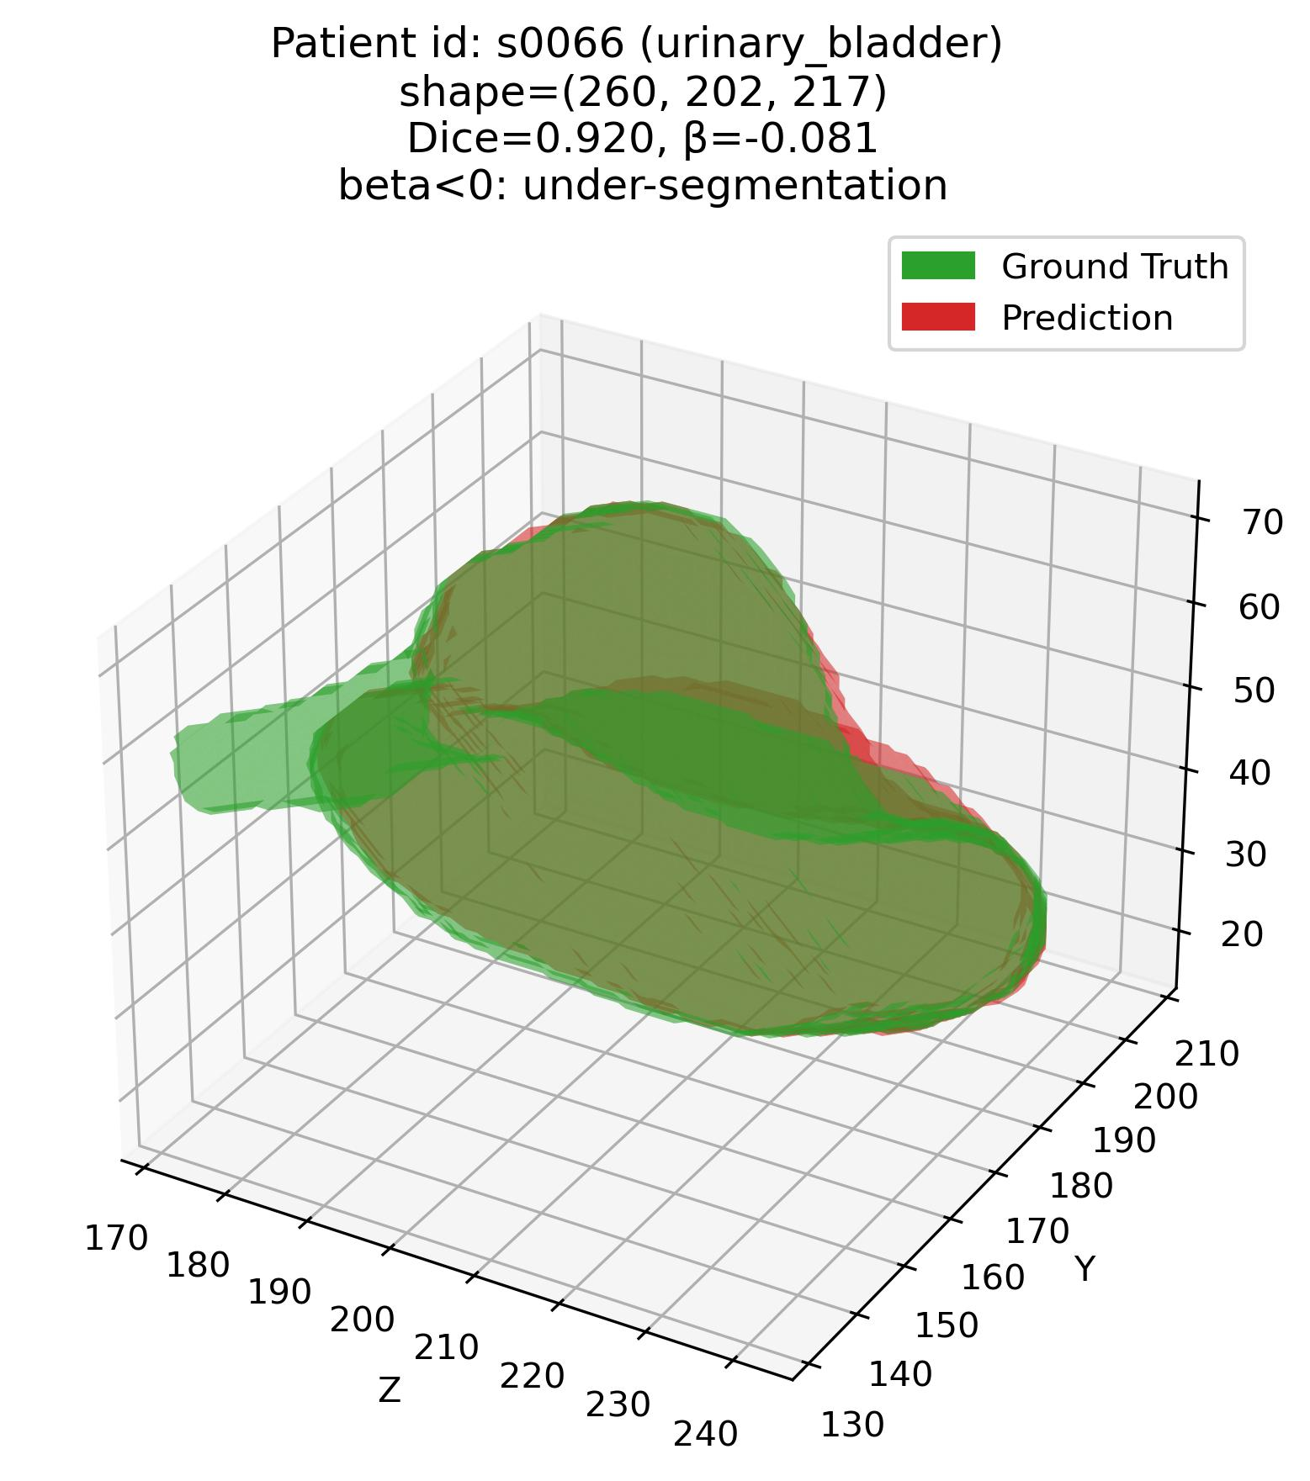
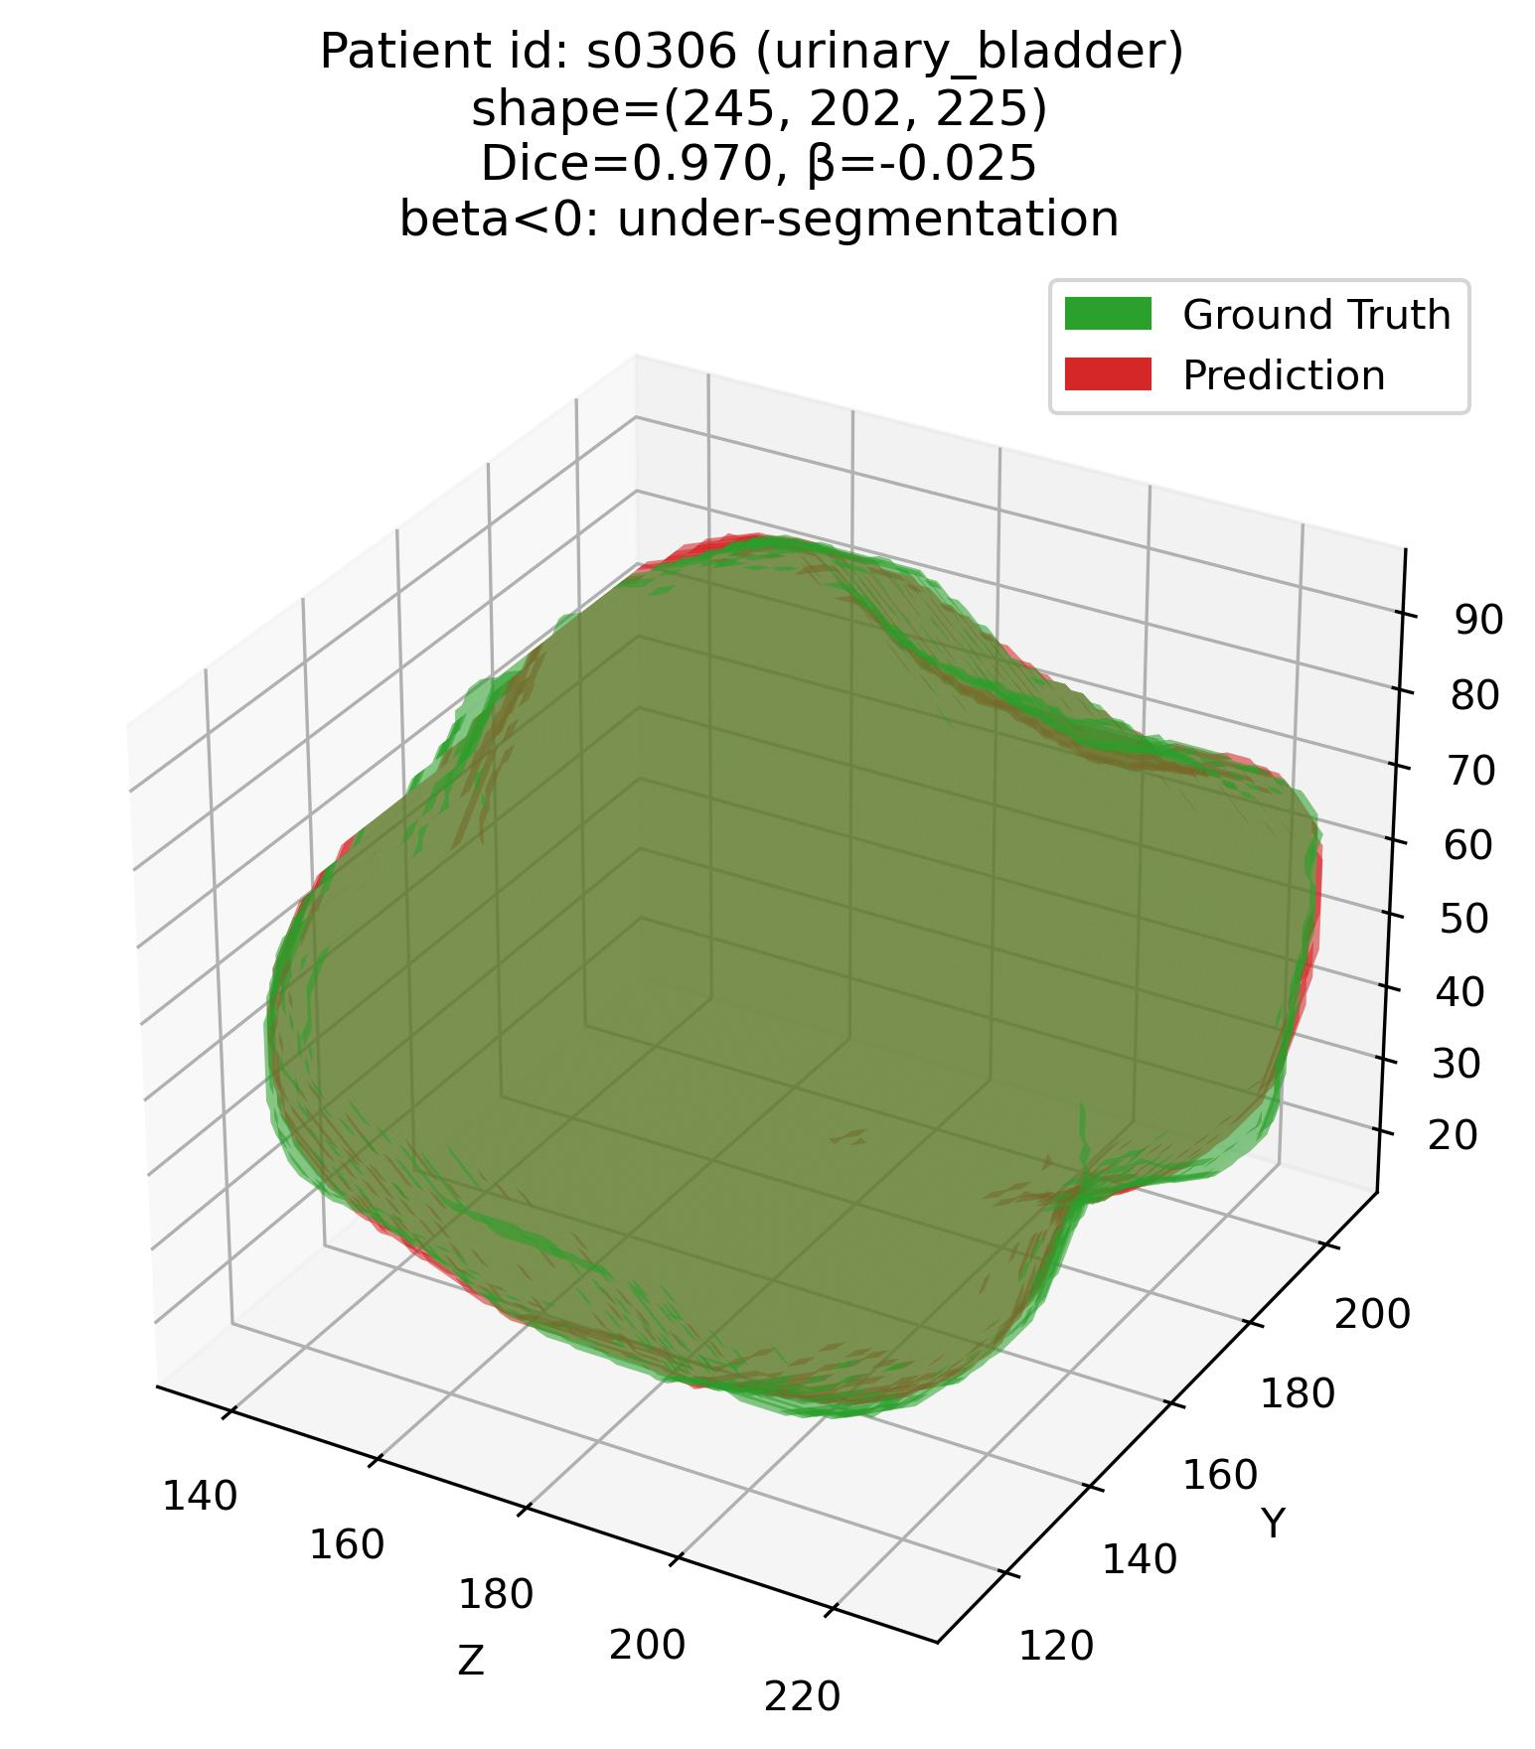
Error characterization protocol
The analysis framework – Q1
Q1: Some examples – 6. Urinary bladder (Moderate – average DSC organ)

Slide 24



Error characterization protocol
The analysis framework – Q1
Q1: Some examples – 6. Urinary bladder (Moderate – average DSC organ)

Slide 25



Error characterization protocol
The analysis framework – Q1
Q1: Some examples – 7. Gall bladder (Moderate – average DSC organ)

Slide 26



Error characterization protocol
The analysis framework – Q1
Q1: Some examples – 7. Gall bladder (Moderate – average DSC organ)

Slide 27



Error characterization protocol
The analysis framework – Q1
Q1: Some examples – 8. Pancreas (Difficult – low DSC organ)

Slide 28



Error characterization protocol
The analysis framework – Q1
Q1: Some examples – 8. Pancreas (Difficult – low DSC organ)

Slide 29



Error characterization protocol
The analysis framework – Q1
Q1: Some examples – 9. Esophagus (Difficult – low DSC organ)

Slide 30



Error characterization protocol
The analysis framework – Q1
Q1: Some examples – 9. Esophagus (Difficult – low DSC organ)

Slide 31



Error characterization protocol
The analysis framework – Q1
Q1: Some examples – 10. Colon (Difficult – low DSC organ)

Slide 32



Error characterization protocol
The analysis framework – Q1
Q1: Some examples – 10. Colon (Difficult – low DSC organ)

Slide 33




Error characterization protocol
The analysis framework – Q1
Q1: Some examples – 11. Adrenal glands (Difficult – low DSC organ)
Patient# s0053 (adrenal glands)
Patient# s0066 (adrenal glands)

Slide 34




Error characterization protocol
The analysis framework – Q1
Q1: Some examples – 11. Adrenal glands (Difficult – low DSC organ)
Patient# s0306 (adrenal glands)
Patient# s0046 (adrenal glands)

Slide 35




Error characterization protocol
The analysis framework – Q1
Q1: Some examples – 11. Adrenal glands (Difficult – low DSC organ)
Patient# s0012 (adrenal glands)
Patient# s0028 (adrenal glands)

Slide 36
Error characterization protocol
The analysis framework – Q2
Q2: Organ-wise characterization of more nuanced errors
Types of analyses:
1. Purely comparative
2. Explanatory (causal)
How does the segmentation model wrongly alter the segmentation characteristics of the organ?
What organ features lead to what kinds of errors?
Examples
Examples
E1. Do models tend to make elongated structured more circular?
E1. Does a rectangular liver lead to under-segmentation as compared to a spherical liver?
E2. Do models tend to combine small sub-structures into a bigger structure?
E2. Is a complex shape more likely to be over-segmented?

Slide 37



Error characterization protocol
The analysis framework – Q2
Q2: Organ-wise characterization of more nuanced errors (2)
1. Purely comparative analyses:
E1. Do models tend to make elongated structured more circular?
E2. Do models tend to combine small sub-structures into a bigger structure?
E3. Do models tend to make nuanced shapes seem more simplistic?
Comparison criteria: same feature in the GT and Pd segmentations.

Slide 38
Error characterization protocol
The analysis framework – Q2
Q2: Organ-wise characterization of more nuanced errors (3)
1. Purely comparative analyses (contd.):
Comparison techniques:
Correlation
Regression (e.g. Simple Linear Regression)
Regression coefficient tells us how much the feature F of the Pd segmentation increases (+ve) or decreases (-ve) with unit increase in F of GT.

Slide 39
Error characterization protocol
The analysis framework – Q2
Q2: Organ-wise characterization of more nuanced errors (4)
2. Explanatory (causal) analyses:
E1. Does a rectangular liver lead to under-segmentation as compared to a spherical liver?
E2. Is a complex shape more likely to be over-segmented?
Comparison criteria: different feature $F_{x}$ in the GT as $F_{y}$ for Pd segmentations.
Note: Error score $β$, is one of the $F_{y}$ features, as we are also interested in what shape statistics might be causing under- or over-segmentation.

Slide 40

Error characterization protocol
The analysis framework – Q2
Q2: Organ-wise characterization of more nuanced errors (5)
2. Explanatory (causal) analyses (contd.):
Comparison techniques:
Correlation
Regression (e.g. Simple Linear Regression)

Slide 41
Error characterization protocol
The analysis framework – Q2
Q2: Organ-wise characterization of more nuanced errors (6)
Features of interest:
1. Measures of anisotropy
2. Features of shape-based complexity
Anisotropy: The elongatedness (non-symmetry) of the 3D shape as a whole.
Exploratory, based on results. I want to follow a similar approach.
Saporta et al 2022 paper [7] features.

Slide 42



Error characterization protocol
The analysis framework – Q2
Q2: Organ-wise characterization of more nuanced errors (7)
1. Features of interest – measures of anisotropy:
i. Sphericity: How closely does a 3D shape resemble a sphere?
$$sphericity (V, A)$$
$$\frac{surface area of sphere with volume V}{surface area of the actual object (A)} =\frac{\sqrt[3]{36πV^{2}}}{A}$$

Slide 43



Error characterization protocol
The analysis framework – Q2
Q2: Organ-wise characterization of more nuanced errors (8)
1. Features of interest – measures of anisotropy (contd.):
ii. Relative surface area excess (RSAE): Ratio of excessive surface area of given 3D geometry, relative to that of largest sphere that can fit completely within the geometry.
$$RSAE$$
$$\frac{Excess surface area (ΔA)}{surface area of largest sphere}$$

Slide 44
Error characterization protocol
The analysis framework – Q2
Q2: Organ-wise characterization of more nuanced errors (9)
2. Features of interest – shape-based complexity:
Influenced heavily by Saporta et al 2022 paper [7] features → although they used saliency maps.
They followed an exploratory approach – I want to do the same.
Not exactly sure what features are the best – without some results.
Using the features in the Saporta et al 2022 [7] paper as a placeholder/ comparison.

Slide 45

Error characterization protocol
The analysis framework – Q2
Q2: Organ-wise characterization of more nuanced errors (10)
2. Features of interest – shape-based complexity (contd.):

Slide 46


Error characterization protocol
The analysis framework – Q3
Q3: Magnitude & direction of error relative to the organ
Goal: Develop a combined metric of 1. anisotropy and 2. direction of the aforementioned anisotropy relative to the organ.
Shape preservation metric$, M1$.

Slide 47



Error characterization protocol
The analysis framework – Q3
Q3: Magnitude & direction of error relative to the organ (2)
Step 1: Tensor representation of the 3D geometry.
The tensor represents:
Direction of maximum elongation
How elongated the shape is in each axis (x, y, z).
Calculate ${\{λ}_{1},λ_{2},λ_{3}\}$ and $\{{v_{1}}^{→},{v_{2}}^{→},{v_{3}}^{→}\}$ from the shape tensor:
[Note: Detailed math provided in protocol]
$\{{v_{1}}^{→},{v_{2}}^{→},{v_{3}}^{→}\}$ provide the directions of $\{l, b, h\}$.
${\{λ}_{1},λ_{2},λ_{3}\}$ provide the magnitude of elongation along $\{{v_{1}}^{→},{v_{2}}^{→},{v_{3}}^{→}\}$.

Slide 48


Error characterization protocol
The analysis framework – Q3
Q3: Magnitude & direction of error relative to the organ (3)
Step 2: Calculate absolute difference in deformation b/w GT and Pd segmentation.
Note: Direction not incorporated in this step, only magnitude of difference.
$Elongation (E) =\sqrt{\frac{λ_{2}}{λ_{1}}}$
$ΔE=| E_{GT}−E_{Pd} |$

Slide 49
Error characterization protocol
The analysis framework – Q3
Q3: Magnitude & direction of error relative to the organ (4)
Step 3: Find alignment b/w major axes of GT and Pd segmentation – How aligned are they?
Note: Direction incorporated in this step.
$Alignment {\left(φ\right)=cos}^{−1}\text{|}{v_{1, GT}}^{→}\text{. }{v_{1, Pd}}^{→}\text{|​}$

Slide 50

Error characterization protocol
The analysis framework – Q3
Q3: Magnitude & direction of error relative to the organ (5)
Reporting elongation + alignment metrics + DSC/NSD/IoU:
DSC/NSD/IoU → for overlap,
$ΔE$ → for magnitude of elongation, and
$φ$ → for alignment of elongation
… between GT and Pd segmentation.
Can be reported per-organ like we do DSC.
But, comparative or explanatory (causal) analyses impossible → because correlation/ regression impossible.

Slide 51
Error characterization protocol
The analysis framework – Q3
Q3: Magnitude & direction of error relative to the organ (5)
Bringing all the components together:
Shape preservation metric, $M1=e^{−ΔE}\text{|}{v_{1, GT}}^{→}\text{. }{v_{1, Pd}}^{→}\text{|​}$
$Range of M1:$
$0,$ when shape is perfectly preserved b/w GT and Pd segmentations.
$1,$ when shape is completely lost b/w GT and Pd segmentations.
Comparative or explanatory (causal) analyses possible → because correlation/ regression possible.

Slide 52
Error characterization protocol
The analysis framework – Q4
Q4: Scalability analyses
Which organ-specific features are scalable – and by how much?
Assumption: I have managed to come up with a good metric that unifies $β$ and $DSC$.
In progress: $β=kβ+\left(1−DSC\right),$ where $0≤k≤1$ controls to what extent $β$ is to be used.

Slide 53




Error characterization protocol
The analysis framework – Q4
Q4: Scalability analyses (2)
Step 1: Fit a Gaussian mixture model (GMM) to the error score ($β$) per organ. Subsequently, find optimal number of components (N) in the GMM-fitted data.
Example data: Histogram of $β$ values
GMM fit on $β$ values (3 modes)

Slide 54
Error characterization protocol
The analysis framework – Q4
Q4: Scalability analyses (2)
Step 2: Extract shape-based features from each of the 3 components corresponding to “under,” “mixed” and “over” segmentation – based on $β−DSC$ combinations.
Step 3: Perform feature selection to find features that are most important in classifying “under,” “mixed” and “bad” segmentations.
⇒ Example: Say, livers that have low circularity, high area and high circumference are associated with “over” segmentations.

Slide 55
Error characterization protocol
The analysis framework – Q4
Q4: Scalability analyses (3)
Going one level deeper:
For feature values that have been identified as causing errors in under/ mixed/ over segmentation, can we tell if they lead to a specific type of under/ mixed/ over segmentation?
⇒ Example before: Say, livers that have low circularity, high area and high circumference are associated with “over” segmentations.
Step 4: Label each “over” segmentation as “low deformation” (preserves GT shape — low $ΔE$), or “high deformation” (does not preserve GT shape — high $ΔE$).

Slide 56
Error characterization protocol
The analysis framework – Q4
Q4: Scalability analyses (4)
Step 5. Fit a decision tree classifier to identify what combinations of feature values lead to low versus high deformation.
⇒ This could be done for any number of aforementioned features — often in the order that we are interested in to get more fine-grained insights.

Slide 57
Error characterization protocol
References
[1] Jeon, Sun Kyung, Ijin Joo, Junghoan Park, Jong-Min Kim, Sang Joon Park, and Soon Ho Yoon. 2024. “Fully-Automated Multi-Organ Segmentation Tool Applicable to Both Non-Contrast and Post-Contrast Abdominal CT: Deep Learning Algorithm Developed Using Dual-Energy CT Images.” Scientific Reports 14 (1): 4378.
[2] Luo, Xiangde, Wenjun Liao, Jianghong Xiao, Jieneng Chen, Tao Song, Xiaofan Zhang, Kang Li, Dimitris N. Metaxas, Guotai Wang, and Shaoting Zhang. 2022. “WORD: A Large Scale Dataset, Benchmark and Clinical Applicable Study for Abdominal Organ Segmentation from CT Image.” Medical Image Analysis 82 (102642): 102642.
[3] Ji, Yuanfeng, Haotian Bai, Jie Yang, Chongjian Ge, Ye Zhu, Ruimao Zhang, Zhen Li, et al. 2022. “AMOS: A Large-Scale Abdominal Multi-Organ Benchmark for Versatile Medical Image Segmentation.” arXiv [Eess.IV]. arXiv. https://proceedings.neurips.cc/paper_files/paper/2022/file/ee604e1bedbd069d9fc9328b7b9584be-Paper-Datasets_and_Benchmarks.pdf.
[4] Wasserthal, Jakob, Hanns-Christian Breit, Manfred T. Meyer, Maurice Pradella, Daniel Hinck, Alexander W. Sauter, Tobias Heye, et al. 2023. “TotalSegmentator: Robust Segmentation of 104 Anatomic Structures in CT Images.” Radiology. Artificial Intelligence 5 (5): e230024.
[5] Bionetworks, Sage. n.d. “Multi-Atlas Labeling Beyond the Cranial Vault - Workshop and Challenge.” Accessed December 16, 2025. https://www.synapse.org/Synapse:syn3193805/wiki/89480.

Slide 58
Error characterization protocol
References
[6] “MICCAI FLARE 2022 - Grand Challenge.” n.d. Grand-challenge.org. Accessed December 16, 2025. https://flare22.grand-challenge.org/.
[7] Saporta, Adriel, Xiaotong Gui, Ashwin Agrawal, Anuj Pareek, Steven Q. H. Truong, Chanh D. T. Nguyen, Van-Doan Ngo, et al. 2022. “Benchmarking Saliency Methods for Chest X-Ray Interpretation.” Nature Machine Intelligence 4 (10): 867–78.

Slide 59
Error characterization protocol
Appendices
Appendices

Slide 60
Error characterization protocol
Some design decisions – D1
D1 – Organs that we are focusing on:
At least for the initial analyses, we focus on the organs fully contained within abdominal CT volumes, namely:
To be excluded:
1. Small intestine
2. Appendix
3. Bile ducts
4. Inferior vena cava
5. Arteries and veins
6. Spine
8. Lymph nodes
9. Lower ribs
1. Liver
2. Pancreas
3. Esophagus
4. Kidneys
5. Adrenal glands
6. Stomach
7. Colon
8. Bladder
9. Gallbladder
10. Aorta

Slide 61
Error characterization protocol
Some design decisions – D1
D1 – Organs that we are focusing on (2):
Why small intestine, appendix, bile ducts, inferior vena cava, arteries and veins, lymph nodes, spine and lower ribs are not included:
They are not “popular” organs, meaning I have not seen them being segmented in many abdominal CT studies.
Consequently, not all databases have these ground truths.
Small intestine, large intestine → often tough to differentiate, also not complete in abdominal CT scans often.
Spine → Not a “popular” thing, also not completely contained in abdominal CT scans.

Slide 62
Error characterization protocol
Some design decisions – D2
D2 – CT datasets to be used in the study:
Selection criteria:
We plan on running pre-trained AI segmentation models on popular CT datasets that fulfill the following criteria:
Criteria 1: Contain either all or a subset of the 11 aforementioned, popular (meaning, commonly studied in segmentation studies on CT datasets), abdominal organs that we are interested in:
1. Liver
2. Pancreas
3. Esophagus
4. Kidneys
5. Adrenal glands
6. Stomach
7. Colon
8. Bladder
9. Gallbladder
10. Aorta

Slide 63
Error characterization protocol
Some design decisions – D2
D2 – CT datasets to be used in the study (2):
Criteria 2: Contain at least 30 CT volumes.
Criteria 3: All volumes in 3D — not 2D (meaning, having multiple 2D slices).
Criteria 4: Have published an AI segmentation model on their data — or are popular enough. Meaning, published at a popular venue such as NeurIPS, CVPR, MICCAI, MIDL et cetera — and therefore have an extensive leaderboard.

Slide 64
Error characterization protocol
Some design decisions – D2
D2 – CT datasets to be used in the study (3):
I plan on using 6, 3D CT datasets that follow the aforementioned criteria:
The DECT/ SECT dataset [1]
TotalSegmentator [4]
WORD [2]
BTCV [5]
AMOS [3]
FLARE [6]

Slide 65
Error characterization protocol
Some design decisions – D3
D3 – AI segmentation models:
4 popular nnUNET-based models + TotalSegmentator:
nnUNET (2D)
nnUNET (3D)
nnUNETV2 (2D)
nnUNETV2 (3D)
TotalSegmentator: It is not a new model methodologically, it is just nnUNet (3D) trained on all organs in the body, across 1200 3D volumes.

Slide 66
Error characterization protocol
The analysis framework – Q1
Q1: Ranking organs as per susceptibility to being under- or over-segmented (2)
Why is a quantitative metric of under-/ over-segmentation important?
With a quantitative metric, we can perform correlation, regression et cetera to infer:
What organ features are susceptible to under-/ over-segmentation?
What region in the organ is susceptible to be under-/ over-segmented?
Correlation-/ regression-based analyses are impossible with categorical independent variables.

Slide 67
Thank you!

